Slide 1
Chapter 8
Solving Second order differential equations numerically

Slide 2
Online lecture materials
The online lecture notes by Dr. Tai-Ran Hsu of San José State University,
http://www.engr.sjsu.edu/trhsu/Chapter%204%20Second%20order%20DEs.pdf
provides a very clear explanation of the solutions and applications of some typical second order differential equations.

Slide 3

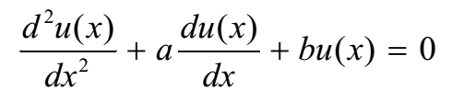

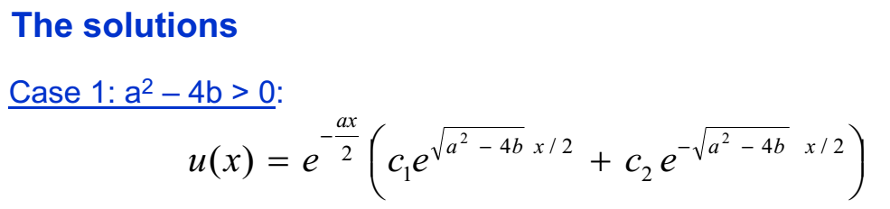
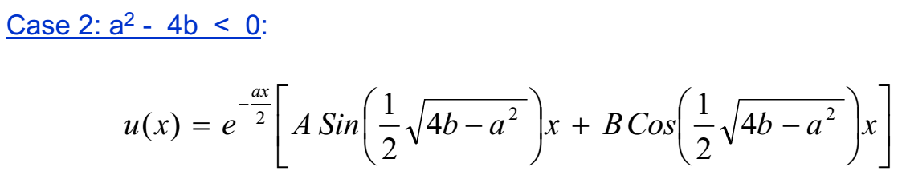

Slide 4
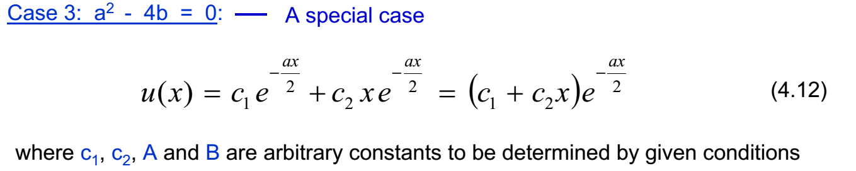

Slide 5
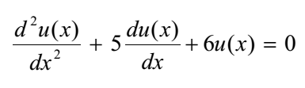

Slide 6


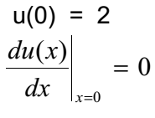


Slide 7
DSolve
DSolve of Mathematica can provide analytical solution to a generic second order differential equation. See Math_built_in_2ODE.nb.

Slide 8
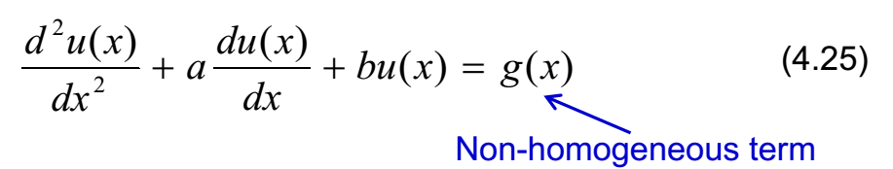
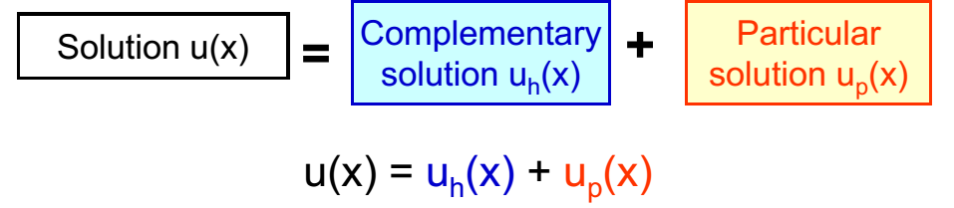
Typical second order, non-homogeneous ordinary differential equations
n(x)

Slide 9


Typical second order, non-homogeneous ordinary differential equations
n(x)

Slide 10

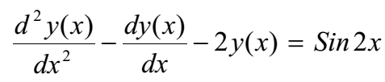




Guess:
After some algebra

Slide 11

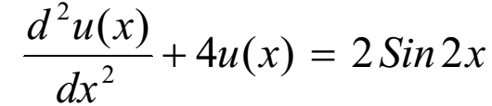
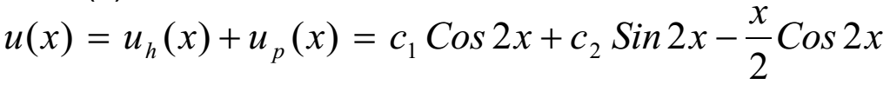

Slide 12

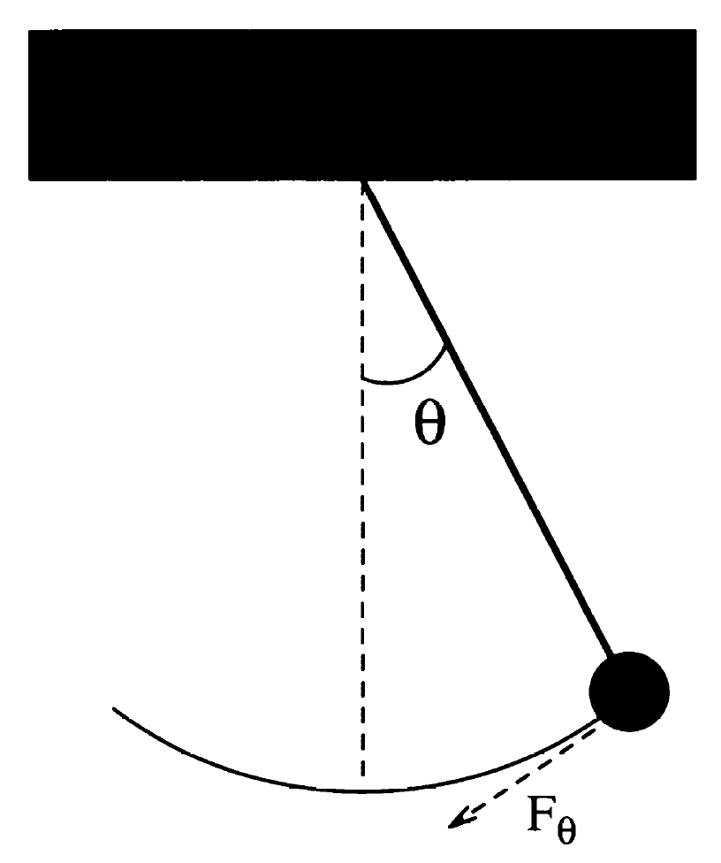
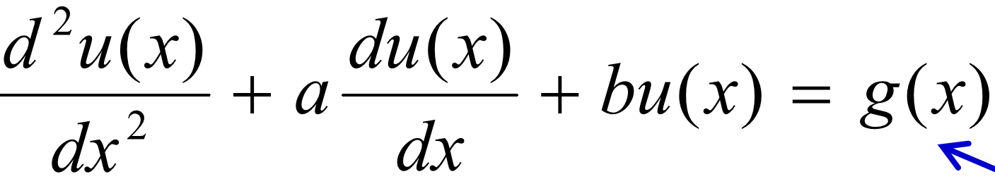

Simple Harmonic pendulum as a special case of second order DE
Force on the pendulum
for small oscillation,
Equation of motion (EoM)
$$F_{θ}=ma_{θ}$$
$−mgsinθ$=$m\frac{dv_{θ}}{dt}=m\frac{d}{dt}\left(\frac{dr}{dt}\right)≈m\frac{d^{2}}{{dt}^{2}}\left(lθ\right)$
$$\frac{d^{2}θ}{{dt}^{2}}≈−\frac{gθ}{l}$$
l
r
The period of the SHO is given by
n(x)
Notes:
12

Slide 13
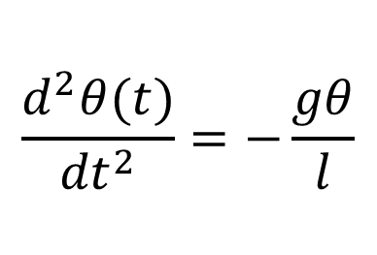
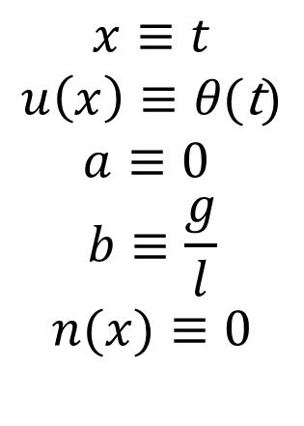
Simple Harmonic pendulum as a special case of second order DE (cont.)
n(x)
$$x≡t$$
$$u\left(x\right)≡θ\text{(}\text{t}\text{)}$$
$$a≡0$$
$$b≡\frac{g}{l}$$
$$n(x)≡0$$
$$\frac{d^{2}θ(t)}{{dt}^{2}}=−\frac{gθ}{l}$$
Notes:
13

Slide 14
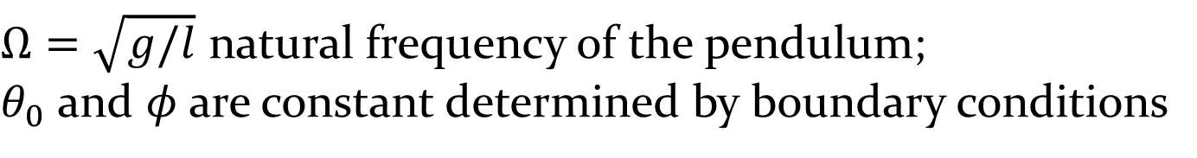
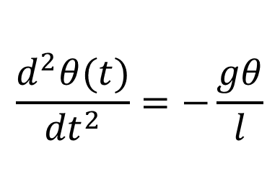
Simple Harmonic pendulum as a special case of second order DE (cont.)
$$\frac{d^{2}θ(t)}{{dt}^{2}}=−\frac{gθ}{l}$$
Analytical solution:
$Ω=\sqrt{g/l}$ natural frequency of the pendulum;
$θ_{0}$ and $φ$are constant determined by boundary conditions
Notes:
14

Slide 15
Simple Harmonic pendulum with drag force as a special case of second order DE
Drag force on a moving object, f_{d} = - kv
For a pendulum, instantaneous velocity v = ωl = l (dθ/dt)
Hence, f_{d} = - kl (dθ/dt).
The net force on the forced pendulum along the tangential direction
l
f_{d}
- kl (dθ/dt).
r
Notes:
15

Slide 16
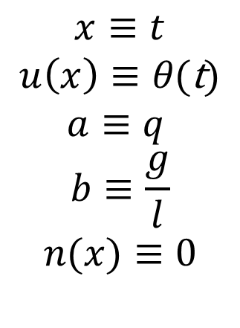
Simple Harmonic pendulum with drag force as a special case of second order DE (cont.)
n(x)
$$x≡t$$
$$u\left(x\right)≡θ\text{(}\text{t}\text{)}$$
$$a≡q$$
$$b≡\frac{g}{l}$$
$$n(x)≡0$$
l
f_{d}
r
Notes:
16

Slide 17
Analytical solution
Underdamped regime (small damping). Still oscillate, but amplitude decay slowly over many period before dying totally.
Overdamped regime (very large damping), decay slowly over several period before dying totally. θ is dominated by exponential term.
Critically damped regime, intermediate between under- and overdamping case.

Slide 18
Overdamped
Critically damped
Underdamped

Slide 19
See 2ODE_Pendulum.nb where DSolve solves the three cases of a damped pendulum analytically.

Slide 20
Adding driving force to the damped oscillator: forced oscillator
Ω_{D} frequency of the applied force
- kl (dθ/dt) + F_{D} sin(Ω_{D}t)

Slide 21
Analytical solution
Resonance happens when

Slide 22
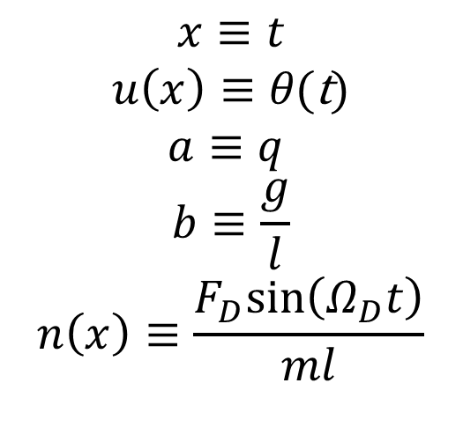
Forced oscillator: An example of non homogeneous 2nd order DE
n(x)
$$x≡t$$
$$u\left(x\right)≡θ\text{(}\text{t}\text{)}$$
$$a≡q$$
$$b≡\frac{g}{l}$$
$$n\left(x\right)≡\frac{F_{D}sin\left(Ω_{D}t\right)}{ml}$$

Slide 23
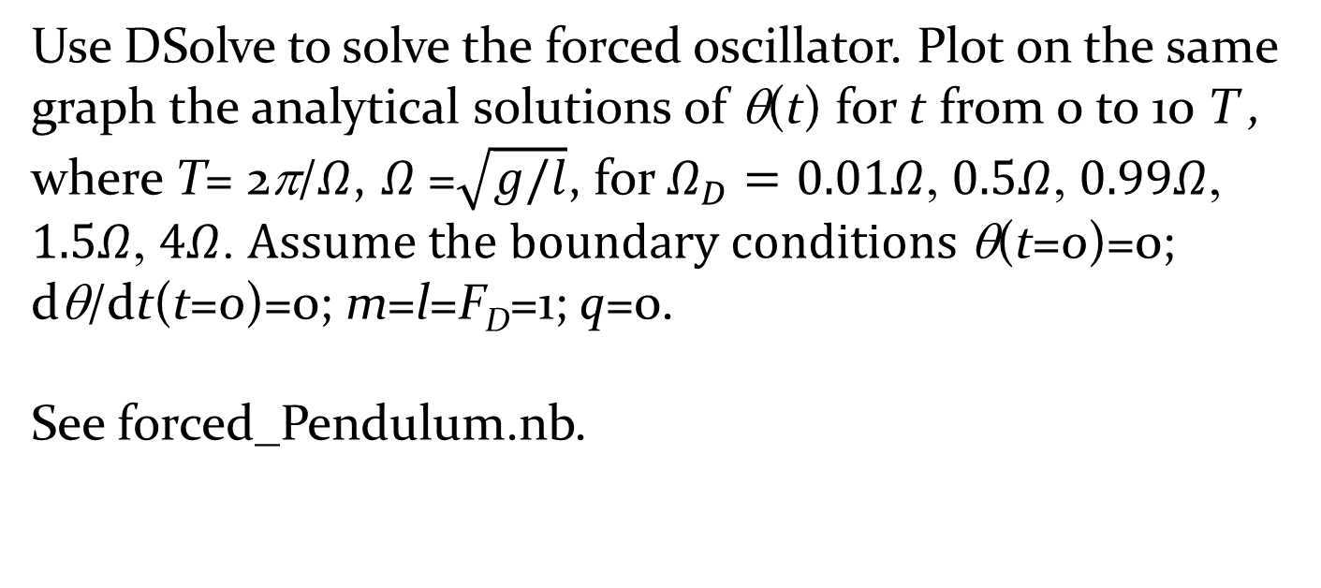
Exercise: Forced oscillator
Use DSolve to solve the forced oscillator. Plot on the same graph the analytical solutions of θ(t) for t from 0 to 10 T , where T= 2π/$Ω$, $Ω$=$\sqrt{g/l}$, for $Ω_{D}=0.01Ω$, $0.5Ω$, $0.99Ω$, $1.5Ω$, $4Ω$. $Assume the boundary conditions$θ(t=0)=0; dθ/dt(t=0)=0; m=l=F_{D}=1; q=0.
See forced_Pendulum.nb.

Slide 24
Second order Runge-Kutta (RK2) method
Consider a generic second order differential equation.
It can be numerically solved using second order Runge-Kutta method. First, split the second order DE into two first order parts:

Slide 25
Algorithm
Set boundary conditions: u(x=x₀)=u₀, u’(x=x₀)=v(x=x₀)=v₀.
calculate
calculate
calculate
calculate

Slide 26

Translating the SK2 algorithm into the case of simple pendulum
$$\frac{d^{2}θ(t)}{{dt}^{2}}=−\frac{gθ}{l}$$
Set boundary conditions:
u(x=x₀)=u₀, u’(x=x₀)=v(x=x₀)=v₀
Set boundary conditions:
θ(t=t₀)= θ₀, θ’ (t=t₀)=ω(t=t₀)=ω₀

Slide 27
Exercise: Develop a code to implement SK2 for the case of the simple pendulum. Boundary conditions:
See pendulum_RK2.nb

Slide 28

Translating the SK2 algorithm into the case of damped pendulum
$$\frac{d^{2}θ(t)}{{dt}^{2}}=−\frac{gθ}{l}−q\frac{dθ}{dt}$$
Set boundary conditions:
u(x=x₀)=u₀, u’(x=x₀)=v(x=x₀)=v₀
Set boundary conditions:
θ(t=t₀)= θ₀, θ’ (t=t₀)=ω(t=t₀)=ω₀

Slide 29
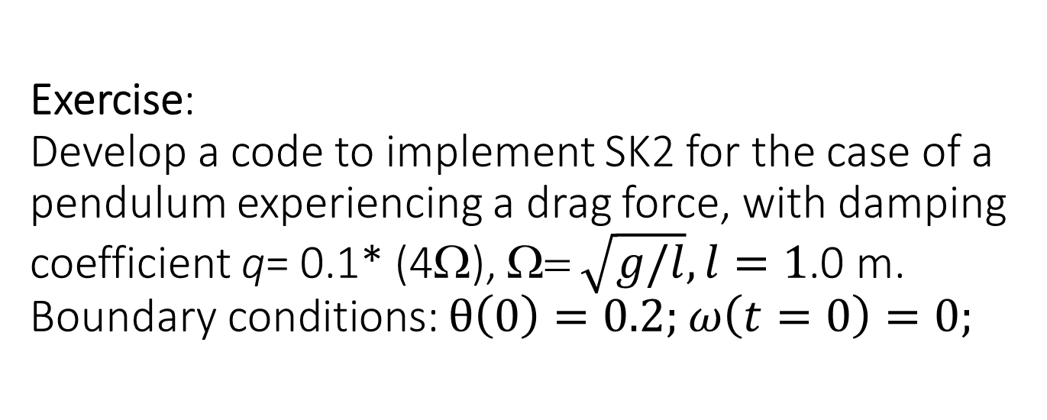
Exercise:
Develop a code to implement SK2 for the case of a pendulum experiencing a drag force, with damping coefficient q= 0.1* (4Ω), Ω= $\sqrt{g/l}, l=1$.0 m. Boundary conditions: $θ\left(0\right)=0.2;$ $ω\left(t=0\right)=0;$
See pendulum_RK2.nb

Slide 30
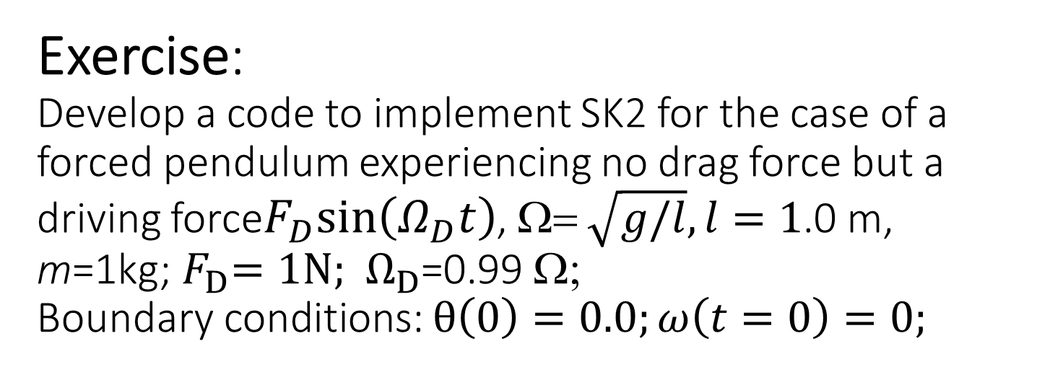
Exercise:
Develop a code to implement SK2 for the case of a forced pendulum experiencing no drag force but a driving force$F_{D}sin\left(Ω_{D}t\right)$, Ω= $\sqrt{g/l},l=1$.0 m, m=1kg;${ F}_{D}=1N;{ Ω}_{D}$=0.99 Ω;
Boundary conditions: $θ\left(0\right)=0.0;ω\left(t=0\right)=0;$

Slide 31
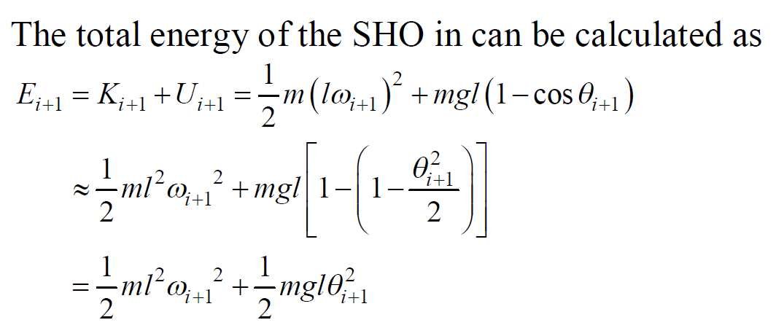
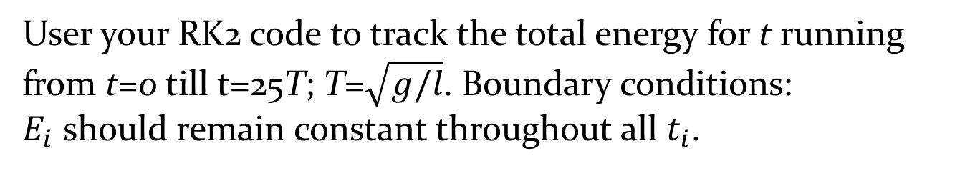
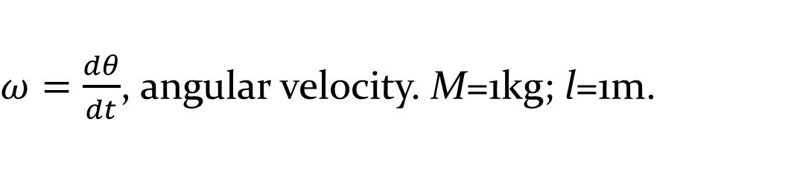
Exercise: Stability of the total energy a SHO in RK2.
$ω=\frac{dθ}{dt}$, angular velocity. M=1kg; l=1m.
User your RK2 code to track the total energy for t running from t=0 till t=25T; T=$\sqrt{g/l}$. Boundary conditions:
$E_{i}$ should remain constant throughout all $t_{i}$.

