Slide 1
ZCE 111
Assignment 10

Slide 2
Application of first order differential equation (DE) in physics
The lecture notes by Prof. Tai-Ran Hsu, San José State University, California, provides many useful application of first order differential equation in real life physics (Ch. 3 - First Order DEs, Ch. 4 - Second Order DEs). We will attempt to solve some of these problems numerically using Mathematica's NDSolve and Nsolve.
For each of the first order DE (with boundary condition provided) listed in Q2 and Q3:
Obtain the Analytical Solution using Dsolve.
Obtain the Numerical Solution using Ndsolve.
Overlay both solutions you have obtained on the same graph.
At the mean time, try read up the lecture note to understand how these equations are derived and interpreted.

Slide 3
Q2
Ans: The analytical solution is

Slide 4
Q3
Ans: The analytical solution is

Slide 5
Q4
Find out, numerically, t_{e}
Ans: The analytical solution is
t_{e}=

Slide 6
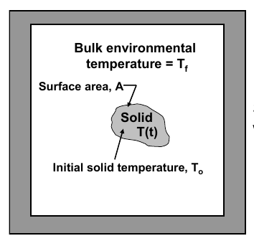
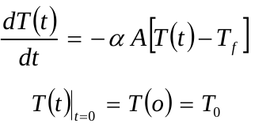
Q5
Ans: The analytical solution is

