Slide 1
ZCE 111 Assignment 12

Slide 2
Q1: RK2 code for forced pendulum
Develop a code to implement RK2 for the case of a forced pendulum experiencing no drag force but a driving force$F_{D}sin\left(Ω_{D}t\right)$, Ω= $\sqrt{g/l},l=1$.0 m, m=1kg;${ F}_{D}=1N;{ Ω}_{D}$=0.99 Ω;
Boundary conditions: $θ\left(0\right)=0.0;ω\left(t=0\right)=0;$

Slide 3
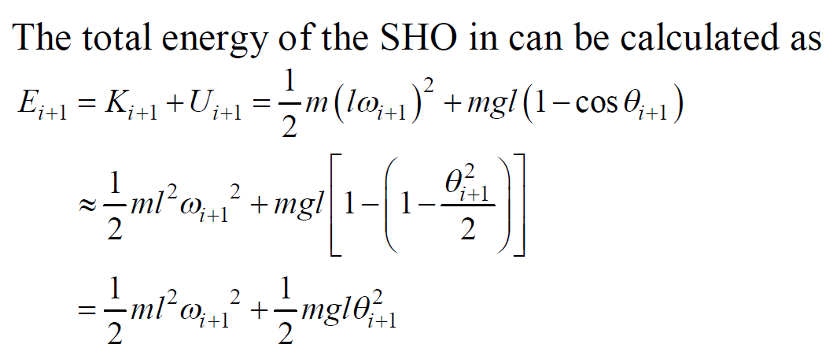
Q2: Stability of the total energy a SHO in RK2.
$ω=\frac{dθ}{dt}$, angular velocity. m=1kg; l=1m.
User your RK2 code to track the total energy for t running from t=0 till t=25T; T=$\sqrt{g/l}$. Boundary conditions: . Check that indeed $E_{i}$ should remain constant throughout all $t_{i}$.

Slide 4
Q3: Planetary motion in polar coordinates
The Earth (E) moves in an elliptical orbit around the Sun (S). In polar coordinate, the equation of motions for the radial and angular coordinate (r,θ) of E with respect to the Sun, are given by
y
$$m\ddot{r}−mr{\left(\frac{L}{mr^{2}}\right)}^{2}=−\frac{GMm}{r^{2}}$$
E
$$mr^{2}\dot{θ}=L$$
S
θ
x
where
O
$$\ddot{r}=\frac{d^{2}r}{dt^{2}};\dot{θ} =\frac{dθ}{dt}$$
L is the angular moment of Earth about the Sun:$L=m\sqrt{GMa(1−ε^{2})};$ $a=1.496×{10}^{11}$m (=1 A.U) (semimajor); m= $5.97×{10}^{24}$kg, mass of Earth; $M=1.987×{10}^{30}$kg, Mass of the Sun;
$G=6.673×{10}^{−11}$Nm²/kg²; $ε=0.017$ (eccentricity). The period is $T=2π\sqrt{\frac{a^{3}}{GM}}$
Notes:
4

Slide 5
Q3: Planetary motion in polar coordinates (cont.)
Solve the radial equation, $m\ddot{r}−mr{\left(\frac{L}{mr^{2}}\right)}^{2}=−\frac{GMm}{r^{2}}$, numerically using your RK2 code, so that you can plot the graph of r as a function of time for t from 0 to the period of the orbit, T (= 1 year). Boundary conditions: $r\left(0\right)=\frac{L^{2}}{GMm^{2}}\frac{1}{\left(1+ε\right)},\dot{r}\left(0\right)=0$.
Hence, plot the angular velocity function $\dot{θ}$(t) as the time varies throughout the year.
Plot the normalised angular function $\frac{θ\left(t\right)}{2π}$ as the time varies throughout the whole period. (*Think carefully how you are going to do this using the prior knowledge you have acquired. Think Euler.)
Visualise the evolution of the Earth’s location, (x(t),y(t)) on the orbit on a x-y plot using the Manipulate function. Your visualization should contain the origin, x- and y-axes.
Notes:
5

