Slide 1
ZCE 111
Assignment 13

Slide 2
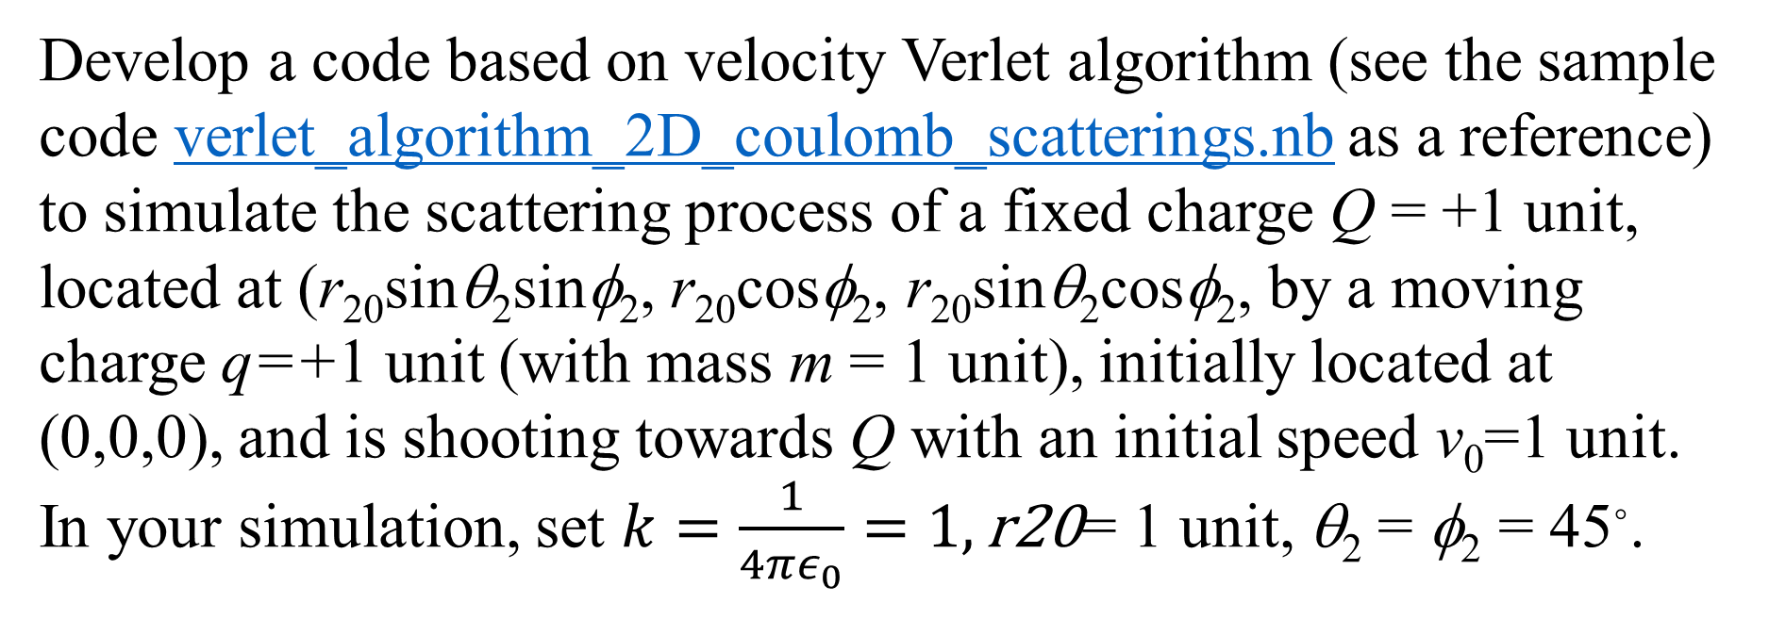
Q1: Coulomb charge scattering in 3D
Develop a code based on velocity Verlet algorithm (see the sample code verlet_algorithm_2D_coulomb_scatterings.nb as a reference) to simulate the scattering process of a fixed charge Q = +1 unit, located at (r₂₀sinθ₂sinφ₂, r₂₀cosφ₂, r₂₀sinθ₂cosφ₂, by a moving charge q=+1 unit (with mass m = 1 unit), initially located at (0,0,0), and is shooting towards Q with an initial speed v₀=1 unit. In your simulation, set $k=\frac{1}{4πε_{0}}=1, \text{r}\text{20}$= 1 unit, θ₂ = φ₂ = 45◦.

Slide 3
Q2: Charge moving in a magnetic field
A charge (mass m and charge q) moving with velocity v =(v_{x}, v_{y}, v_{z}) in a magnetic field B=(B_{x}, B_{y}, B_{z}) experiences a velocity-dependent Lorentz force F=(F_{x}, F_{y}, F_{z}) = q v × B. Develop a code based on the Störmer-Verlet integration algorithm to simulate the dynamical path of the charge particle moving through the magnetic field. Assume: q=+1 unit, mass m = 1 unit, initially located at (0,0,0), initial velocity (v_{0x},v_{0y}, v_{0z}), v_{0x}=v_{0y}=0.1 unit, v_{0z} =0.05 unit, B=(0, 0, B_{z}), B_{z} = 0.1 unit. You should see a helical trajectory circulating about the z-direction.
(my code: verlet_algorithm_3D_coulomb_helix.nb)

