Slide 1
ZCE 111
Assignment 4

Slide 2
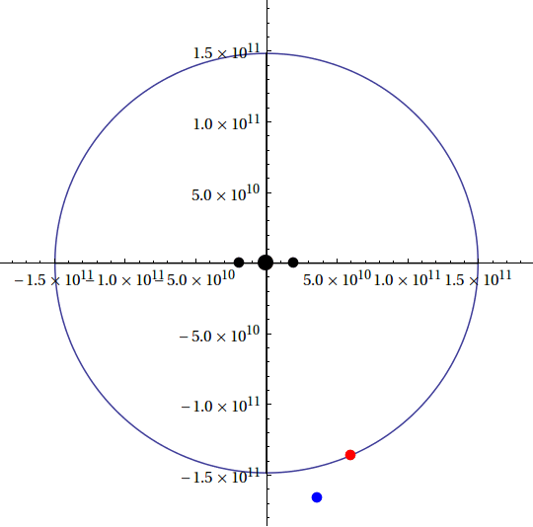
Q1. Hypothetical Sun-Earth-Moon three-body system
The Earth (E) is circulating the Sun (S) which is located at the focus of an elliptical orbit, while the Moon (M) is orbiting the Earth. See figure.
S
E
M

Slide 3
Q1. A Hypothetical Sun-Earth-Moon three-body system
Given the following information of a hypothetical Sun-Planet-Moon system:
Earth-Sun orbit: eccentricity e_{ES} = 0.0167086; semimajor = a_{ES} = 1.496×10¹¹ m;
M_{S} = 1.989×10³⁰ kg.
The Moon-Earth orbit: eccentricity e_{ME} = 0.0549; semimajor = a_{ME} = (3.844×10⁸)×10² m;
M_{E} = 5.9723×10²⁴ kg.
Assume the following initial conditions: at t=0, the Earth is located at the periheron and the Moon is located at the apogee.
1. Simulate the Earth’s orbit around the Sun based on astronomical information given.
2. Add in the moon to (1) above to simulate the full three-body system.
Hint: You will need the formula that relates the period and semimajor of a circulating object around a central mass M:

Slide 4
Q2. Measuring the Earth-Sun system
Write a code to measure the angular speed of Earth with respect to the Sun as a function of time.
Assume the following initial conditions: at t=0, the Earth is located at the periheron.

Slide 5
Q3. A hyperbolic orbit of a two-body system
Refer: https://en.wikipedia.org/wiki/Kepler_orbit
Consider a hypothetical planet-comet system with the following parameters:
Mass of the central planet, M = 1.5*10^(24) kg;
Semimajor of the comet, a = 1.5*10^(8) m; ecentricity e=2.0; The seminor is related to the semimajor via
b = a*Sqrt[e^2 – 1];
while the semi-latus p is related to e and a via
p = a (e^2 – 1);
Assuming the planet is located at the origin (0,0), the distance r of the comet from the planet is given by
r(t) = p / (1 – e* Cos θ(t)),
where
θ(t)=ωt,
ω the angular frequency, ω=2π/T, T the period of the comet, given by
T = 2 π*Sqrt[a^3/(G*M)].

Slide 6
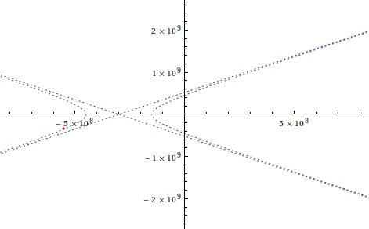
You must use ListPlot[] and Table[] for this problem. Don't use Graphics[Point]. (1) Write a code to determine the smallest and largest x and y coordinates of the comet from the planet, xmin, xmax, ymin,ymax. (2) Simulate the system, using and time interval of Δt=0.001T. Scale your plot accordingly so that the hyperbolic curve is clearly displayed. (3) Use your code to print out the value of the speed of the comet at the time t= 0.05 T. Your output should look like this (with animation of the comet moving along the hyperbolic trajectory)

