Slide 1
Chapter 2
Displaying and customizing various kinds of plot;
Basic animation

Slide 2
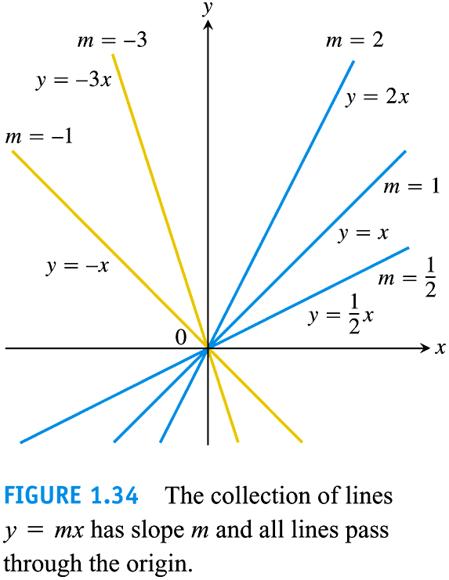
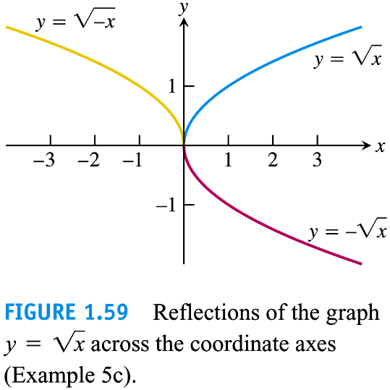

Slide 3
Plot a few functions on the same graph
Reproduce the previous plots using Mathematica
Syntax required:
f[x_]:=; Plot; List;
To customize the plots:
PlotRange;PlotStyle;AxesLable;PlotLabel; PlotLegend
See sample code: C2_plotfunctions.nb

Slide 4
Another example of customizing a function plot
Black Body Radiation: a function of several variables

Slide 5
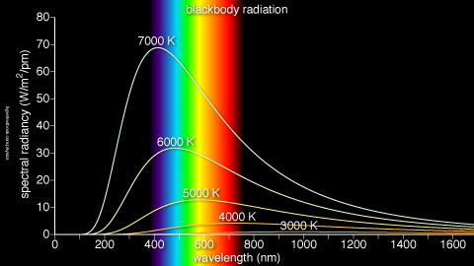
Black Body Radiation

Slide 6
Exercise
Plot Planck’s law of black body radiation for various temperatures on the same graph by defining R as a function of two variables.
Define function of two variables:
h, c,T, are constants

Slide 7
Plotting a sum of terms
Instead of an explicit function (as done previously), we plot a series, which is a ‘function’ comprised of the sum of many terms with specified coefficients.

Slide 8
Generating a series using Sum[]
The function $f\left(x,N_{0}\right)=\sum_{n=1}^{n=N_{0}}{x^{n}}$ can be expressed in Mathematica as
f[x_,N0_]:=Sum[x^n,{n,1,N0}]
Use these to numerically verify that the infinite series representation of a function converges into the generating function.

Slide 9
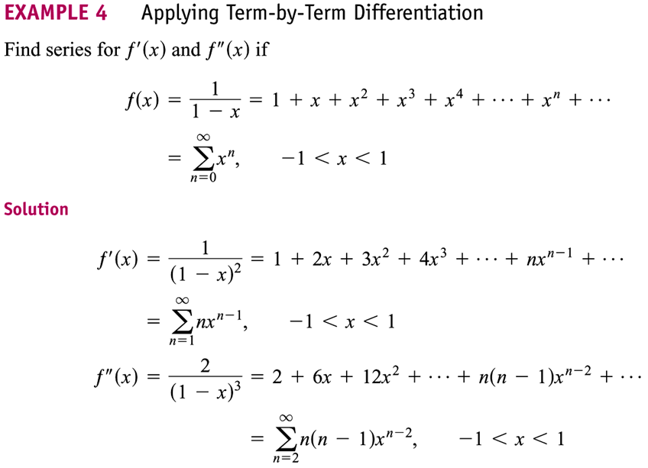

Slide 10
Mathematica sample codes
f(x)=1/(1-x)
f(x)=1/(1+x)
Show that the power series representations converge to the generating functions within the radius of convergence.

Slide 11
Example 2 Finding Taylor polynomial for e^{x} at x = 0

Slide 12
Mathematica sample codes
f(x)=exp (x)
Show that the Taylor series representations of e^{x} at x = 0 converge to the generating functions for all values of x

Slide 13
Application to selected physical systems
Visualisation of
wave and wave pulse propagation
Geometrical optics: Ray-tracing of lens
2D projectile motion
Circular motion
Elliptic motion
Simple harmonic motion

Slide 14
Constructing wave pulse
Two pure waves with slight difference in frequency and wave number Δω = ω₁ - ω₂, Δk= k₁ - k₂, are superimposed

Slide 15
Envelop wave and phase wave
The resultant wave is a ‘wave group’ comprise of an `envelop’ (or the group wave) and a phase waves

Slide 16
Wave pulse – an even more `localised’ wave
In the previous example, we add up only two slightly different wave to form a train of wave group
An even more `localised’ group wave – what we call a “wavepulse” can be constructed by adding more sine waves of different numbers k_{i} and possibly different amplitudes so that they interfere constructively over a small region Δx and outside this region they interfere destructively so that the resultant field approach zero
Mathematically,

Slide 17
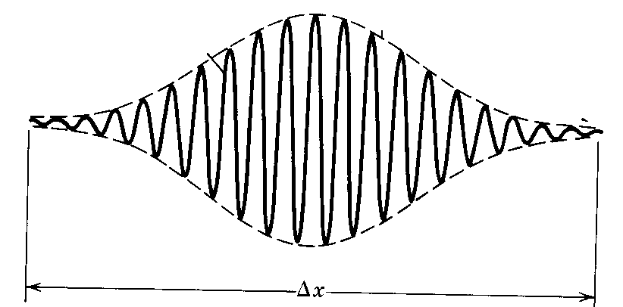
A wavepulse – the wave is well localised within Δx. This is done by adding a lot of waves with with their wave parameters {A_{i}, k_{i}, ω_{i}} slightly differ from each other (i = 1, 2, 3….as many as it can)

Slide 18
Exercise: Simulating wave group and wave pulse
Construct a code to add n waves, each with an angular frequency omegai and wave number ki into a wave pulse for a fixed t.
Display the wave pulse for t=t0, t=t1, …, t=tn.
Syntax: Manipulate
Sample code: C2_wavepulse.nb

Slide 19
Ray-tracing of concave and convex lens
Using Graphics[Points, Lines] to
calculate and visualize the image formed by an object in a concave or convex lens

Slide 20
Image formation by a convex lens
An object with a size $h_{o}$ placed a distance $x_{o}$ from the center C of a convex lens (with focal length f > 0) will form an image with size $h_{i}$ at a distance $x_{i}$from C.
The image can be magnified/diminished, virtual/real or inverted/erect.

Slide 21
Formation of a real, inverted and magnified image in a convex lens by an erected object
Ray 1
T_{o} (x_{o}, h_{o})
|f|
Ray 2
OBJECT,O
B_{i} (x_{i}, 0)
focal point, F
focal point, F
Optical axis
optical center, C
B_{o} (x_{o}, 0)
|f|
IMAGE,I
T_{i} (x_{i}, h_{i})
convex lens

Slide 22
Inverted and erected image
Assume the object is erect, with its tip located at a point T_{o} (x_{o}, h_{o}) above the optical axis, and its base B_{o} (x_{o}, 0) located on the optical axis.
The image in a convex lens can be inverted or erect.
The image is said to be inverted if its tip T_{i} (x_{i}, h_{i}) is on the opposite side as that of the object’s tip, with the base of the object B_{i} (x_{i}, 0) located on the optical axis.

Slide 23
Real and virtual image
If the image is on the same side as that of the object, the image is virtual
Otherwise, it is real.

Slide 24
Magnification
Magnification of the image is given by $m=\frac{|h_{i}|}{{|h}_{o}|}$.
If |m| > 1, image is magnified; |m| < 1, image is diminished.

Slide 25
Formation of image in a convex lens via geometrical ray tracing
A ray from the tip of object parallel to optical axis (Ray 1) shall go through the focal point on the other side of the lens
A ray from the tip of the object (Ray 2) shall pass through the lens center C in a straight line.
The intersection of both rays is the location of the tip of image.

Slide 26
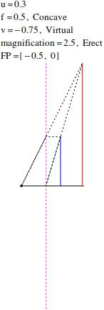
Examples of image formation by a convex lens

Slide 27
The coordinates of the image tip T_{i}(x_{i}, h_{i})
The coordinates of the image tip T_{i}(x_{i}, h_{i}) can be obtained by solving the simultaneous equations of Ray1 and Ray2.
Ray1: $y_{1}=\frac{h_{0}}{f}x$+$h_{0}$
Ray2:$y_{2}=\frac{h_{0}}{x_{0}}x$
$Solving y_{1}$=$y_{2}$,
$x_{i}=\frac{x_{0}f}{f−x_{0}},$ $h_{i}=\frac{h_{0}f}{f−x_{0}}$

Slide 28
Coding exercise for convex lens
Develop a code that reads in supplied values of f of a convex lens, $h_{o}$, $x_{o}$of an object and does the following:
visualise the set-up, display the object, image, lens, focal point and optical axis graphically.
form the image of the object via the geometrical ray tracing method.
Visualise your output for $x_{o}$varies from 0.2$f$till 3$f$at an interval of 0.1$f.$

Slide 29
Syntax:
Graphics
Point[{P1,P2,P3,…}]
PointSize
Lines[{P1,P2,P3,…}]
Color
Dotted
PlotLabel
Column
Sample code: C2_ray_tracing_of_convex_lens.nb

Slide 30
Parametric equations for circular motion
The parametric equations for the x and y coordinates of an object executing circular motion are given by
$x(t)=h+Rcos(ω0t$), $y\left(t\right)=k+Rsin\left(ω0t\right)$
C(h,k) center of the circle; R radius; t parameters. For a complete circle, t varies from t=0 to t=T, T = period of the circular motion, with $ω0=\frac{2π}{T}$ the angular frequency.
Eliminating the parameter t from the parametric equations, the ordinary-looking equation for a circle is deduced:
$${\left(\frac{x−h}{R}\right)}^{2}+{\left(\frac{y−k}{R}\right)}^{2}=1$$

Slide 31
Visualising a circle via ParametricPlot[]
The trajectory can be plotted using ParametricPlot.
You can combine few plots using Show[] command.
See sample code: C2_circular.nb

Slide 32
2D projectile motion (recall your Mechanics class)
The trajectory of a 2D projectile with initial location ($x_{0}$, $y_{0}$), speed $v_{0}$ and launching angle $θ$ are given by the equations:
$x\left(t\right)=x_{0}+v_{0}t\cos{θ;}y\left(t\right)=y_{0}+v_{0}t\sin{θ+\frac{g}{2}t^{2}}$, for t from 0 till T, defined as the time of flight, T =-${2(y}_{0}+v_{0}\sin{θ)/g}$.
$g=−9.8$1;

Slide 33
2D projectile motion
Plot the trajectories of a 2D projectile launched with a common initial speed but at different angles
Plot the trajectories of a 2D projectile launched with a common angle but different initial speed.
Sample code: C2_2Dprojectile.nb
For a fixed v0 and theta, how would you determine the maximum height numerically (not using formula)?

Slide 34
Exercise: Simulating SHM
A pendulum executing simple harmonic motion (SHM) with length L, released at rest from initial angular displacement $θ_{0}$, is described by the following equations: $θ\left(t\right)=θ_{0}\cos{ω0t,}ω0$=$\sqrt{\frac{g}{L}}.$ The period T of the SHM is given by $T$=2π/ω$0$.
Simulate the SHM using Manipulate[]
Hint: you must think properly how to
specify the time-varying positions of the
pendulum, i.e., (x(t),y(t)).
See C2_simulate_pendulum.nb
O
θ
L

Slide 35
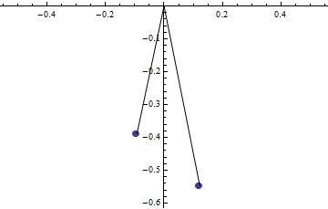
Exercise: Simulating SHM
Simulate two SHMs with different lengths L1, L2:
Plot the phase difference between them as a function of time.

Slide 36
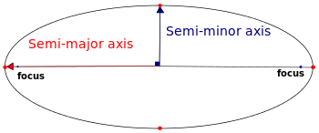
Ellipse
http://en.wikipedia.org/wiki/Semi-major_axis
In geometry, the major axis of an ellipse is its longest diameter: line segment that runs through the center and both foci, with ends at the widest points of the perimeter. The semi-major axis, a, is one half of the major axis, and thus runs from the centre, through a focus, and to the perimeter. Essentially, it is the radius of an orbit at the orbit's two most distant points. For the special case of a circle, the semi-major axis is the radius. One can think of the semi-major axis as an ellipse's long radius.
b
a
C(h,k)

Slide 37
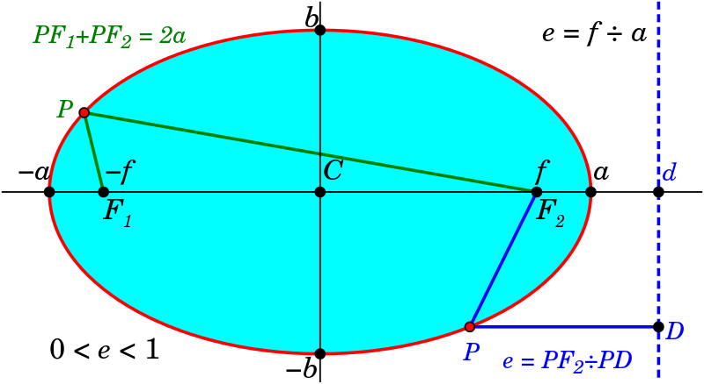
Geometry of an ellipse
The distance to the focal point from the center of the ellipse is sometimes called the linear eccentricity, f, of the ellipse.
In terms of semi-major and semi-minor, f² = a² −b².
e is the eccentricity of an ellipse is the ratio of the distance between the two foci, to the length of the major axis or e = 2f/2a = f/a.
Semimajor and semiminor is related by e via $b=\sqrt{1−e^{2}}$

Slide 38
Elliptic orbit of a planet around the Sun
b
a
C(h,k)
Consider a planet orbiting the Sun which is located at one of the foci of the ellipse.
The coordinates of the planet at time t can be expressed in parametrised form:
$x(t)=h+acos(ω0t$), $y\left(t\right)=k+bsin\left(ω0t\right)$

Slide 39
Elliptic orbit of a planet around the Sun
Or equivalently,
$${\left(\frac{x−h}{a}\right)}^{2}+{\left(\frac{y−k}{b}\right)}^{2}=1$$
where x, y are the coordinates of any point on the ellipse at time t, a, b are semi-major and semi-minor.
C(h,k) are the coordinates of the ellipse's center.
$ω0$ is the angular speed (a constant) of the planet. $ω0$ is related to the period T of the planet via T=2π /$ω0$
Note that an ellipse is just a generalization of a circle with its radius now replaced by a semimajor a and a semmiinor b.
The period T is related to the parameters of the planetary system via $T=\text{2}\text{p}\sqrt{\frac{a^{3}}{GM}}$, where M is the mass of the Sun.

Slide 40
Exercise: Generate an ellipse using ParametricPlot[] and Show[]
Display the parametric plot for an ellipse with your choice of h, k, a, b.
Mark also the foci and the center C(h,k) in your plot.
See sample code: C2_ParametricPlot_ellipse.nb
Modify the simple code to also mark the major and minor axes in your plot.
How would you simulate a point going around the ellipse as time advances?

Slide 41
Simulation of three-body Sun-Planet-Moon
At this point of time, you should be able to perform a simulation of three-body Sun-Planet-Moon system.

Slide 42
Manipulate List (Array) for measuring a two-body planetary system
Simulation of the two-body Sun-Earth system using Grapics[] and Points[] is good for visual display purpose.
How to perform numerical measurement on the system, e.g., the distance and speed of the planet as a function of time.
As an illustration, let’s measure the distance of the Earth from the Sun, and the speed of the Earth, both as a function of time.
See sample code: C2_measure_EarthMoon.nb

