Slide 1
Chapter 4
Data Manipulation and visualisation

Slide 2
A particle in a box
Algorithm to simulate a particle moving freely in a rectangular box with edge L:
Define the length of the box, L.
Specify the coordinates of the four corners of the box.
Draw the box
Generate a particle at a random initial position (x0,y0) located within the box.
Give the particles a random initial velocity, v0.
Let the particle’s position to evolve in time at the constant initial velocity for a period of time defined in terms of the time scale of the system, T0= v0/L.
Simulate the trajectory of the particle as time evolves
When the particle touches the edges, impose a boundary condition: (a) fixed (b) or periodic boundary condition.

Slide 3
Simulate single particle in a 2D box
See C4_simulate_1Pbox.nb
Syntax:
Graphics[Point]
Graphics[Line[{Table[coordinates[n], {n, 1, 5}]}]]
Random[]
Graphics[Point[coordxy[it]];
Graphics[{PointSize[0.025], Point[coordxy[it]]}
PlotRange -> {{0, L}, {0, L}}];

Slide 4
Generalise to N Particle in a 2D box
The code comprises of 1 particle in a 2D box can be easily generalised to N particles, see C4_simulate_NPbox.nb.

Slide 5
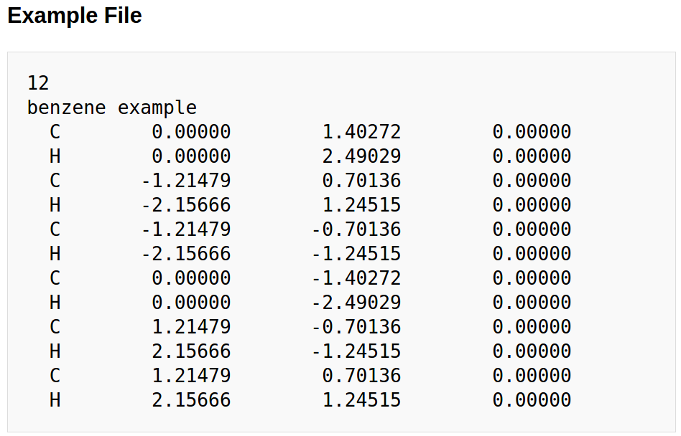
Data in XYZ format
See http://openbabel.org/wiki/XYZ_(format) for data file in XYZ format.

Slide 6
Visualising sample XYZ data
Download and install VMD at either
http://www2.fizik.usm.my/tlyoon/Downloads/vmd191beta1win32.msi
http://www.ks.uiuc.edu/Development/Download/download.cgi?PackageName=VMD
Download the sample XYZ data files N3PD.xyz.
Use VMD to visualise N3PD.xyz.

Slide 7
Exercise: Output snapshots of animation data into a XYZ data file
How would you export all the animation data generated by C4_simulate_NPbox.nb into a XYZ formatted file? To this end, let’s do a simple exercise:
Modify the code C4_simulate_NPbox.nb so that the output is exported to a data file named data2D.xyz. I will call this modified code C4_simulate_NPbox_export.
For this case we shall learn to use a new command:
OpenWrite; FormatType -> OutputForm;

Slide 8
N Particle in a 3D box
C4_simulate_NPbox.nb can be generalized to animate N free particles moving in a 3D box.
To this end, you need to use a new command:
Graphics3D[]
Exercise: do this, and name your code C4_simulate_NPbox3D.nb.

Slide 9
Exercise
Based on the code C4_simulate_NPbox3D.nb you have developed earlier,
export the simulated data for N “Carbon” atom moving in a 3D box into a XYZ formatted file named NP3D.xyz
Use VMD to visualise your NP3D.xyz.
Name you code C4_simulate_NPbox3D_export.nb

Slide 10
Exercise: Visualise XYZ data file in Mathematica
Develop a code to visualize NP3D.xyz using Mathematica automatically without manual intervention. Name your code as C4_visualiseXYZ.nb

Slide 11
Exercise: log.lammps
If you are given a data file with some fixed format other than XYZ, can you write a code to read in the data, process them and visualise the content according to your need?
Try this out on the file log.lammps, which is part of an output produced by a Molecular Dynamics simulation software package LAMMPS.
log.lammps is a formated file containing assorted information of the LAMPPS output, such as "Step" "Atoms" "Temp" "Press" "PotEng" "KinEng" "TotEng" "Volume" "Enthalpy

Slide 12
Exercise: log.lammps
Write a Mathematica code to abstract the data of "Step" "Atoms" "Temp" "Press" "PotEng" "KinEng" "TotEng" "Volume" "Enthalpy from log.lammps.
Then plot
Temp vs. Step
PotEng vs. Step
PotEng vs. Temp
See sample code: C4_loglammps.nb

