Slide 1
Chapter 5
Numerical Root Findings

Slide 2
Root of a continuous function
The roots of a function f(x) are defined as the values for which the value of the function becomes equal to zero. So, finding the roots of f(x) means solving the equation f(x) = 0.
The value of x=r such that f(r)=0 is the root for the function f.
Given a continuous function in an interval, how do we find it roots?

Slide 3
Bisection method
We shall refer to the lecture notes by Dr Dana Mackey, Dublin Institute of Technology: http://www.maths.dit.ie/~dmackey/lectures/Roots.pdf

Slide 4
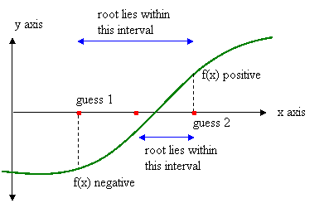
Bisection method, figure
Figure credit: http://cse.unl.edu/~sincovec/Matlab/Lesson%2010/CS211%20Lesson%2010%20-%20Program%20Design.htm

Slide 5
The algorithm of bisection method
Suppose we wish to find the root for f(x), and we have an error tolerance of ε (the absolute error in calculating the root must be less that ε).
Step 1: Find two numbers a and b at which f has different signs.
Step 2: Define c = (a + b)/2.
Step 3: If |f(c)| ≤ ε then accept c as the root and stop.
Step 4: If f(a)f(c) ≤ 0 then set c as the new b. Otherwise, set c as the new a. Return to step 1.

Slide 6
Exercise
Find a root of the equation
x⁶ − x − 1 = 0
accurate to within ε = 0.001.
We will need to implement the algorithm using While command.
See C5_bisection_rootfinding.nb.
The function contains two roots but the code only finds one. As an exercise, modify it to find the other root manually.

Slide 7
Exercise
Modify the code C5_bisection_rootfinding.nb so that it can automatically find both roots of the equation
x⁶ − x − 1 = 0
accurate to within ε = 0.001, without manual intervention.

Slide 8
Exercise
Modify your code further so that, given any continuous function f(x), it can
(i) Count the number of roots in a domain [a,b].
(Sample code, C5_bisection_rootscounting.nb)
(ii) Evaluate each of these roots one by one in sequence.
Try your code on the following functions
(i) f(x) = (1/x) sin x, for -2.5π ≤ x ≤ 2.5π.
(ii) f(x) = tan(πx) − x − 6, for -π ≤ x ≤ π.
(iii) f(x) = e^{x} − x − 2, for all x.
(iv) f(x) = x³ + 2x² − 3x − 1, for all x
Use ε = 0.001. You code is suppose to be able to find out the roots in all the functions automatically and without manual intervention.

Slide 9
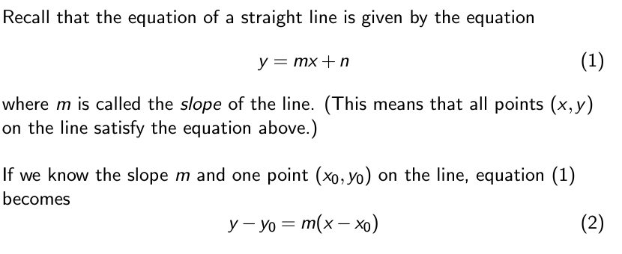
Newton's Method

Slide 11
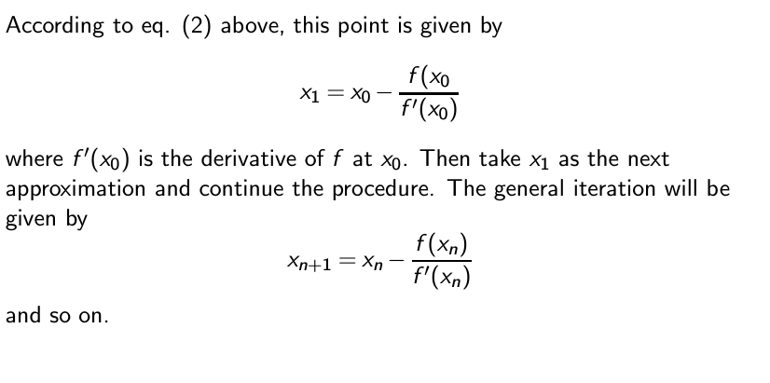

Slide 12
Newton's Method
The code C5_Newton_method_root_finding.nb finds a root of the following equations using Newton method based on an initial guess:
Use ε = 0.001.
(i) f(x) = (1/x) sin x, for -2.5π ≤ x ≤ 2.5π.
(ii) f(x) = tan(πx) − x − 6, for -π ≤ x ≤ π.
(iii) f(x) = e^{x} − x − 2, for all x.
(iv) f(x) = x³ + 2x² − 3x − 1, for all x

Slide 13
Exercise
Modify your previous code so that it can find all the roots using Newton's method for all the following functions automatically and without manual intervention:
Use ε = 0.001.

Slide 14
Mathematica built-in function to find roots
Syntax: FindRoot. NSolve.
NSolve find multiple solutions automatically, but may fail in certain types of equations. Best used for algebraic equations and polynomials.
FindRoot finds only one root at a time, and needs an initial guess value. More robust than Nsolve.

Slide 15
Example of NSolve
NSolve[x^5 - 2 x + 3 == 0, x]
NSolve[x^5 - 2 x + 3 == 0, x, Reals]
NSolve[(x^2 - 1) (x^4 - 1) == 0, x, Reals]
NSolve[Sqrt[x] + 3 x^(1/3) == 5, x, Reals]
NSolve[E^x - x == 7, x, Reals]
NSolve[E^(2 E^x) - Log[x^2 + 1] - 20 x == 11, x, Reals]
NSolve[2 x^(123451/67890) - x^2 + 4 Sqrt[x] - 4 x - 9/8 ==
0, x, Reals]
NSolve[E^(2 x) + x^4 + 4 (x^2 + 1) == (2 x^2 + 4) E^x, x, Reals]
NSolve[10 Sin[Tan[E^-x^2]] - x == 3, x, Reals]
NSolve[2 Sin[Exp[x]] - Cos[Pi x] == 3/2 && -1 < x < 1, x, Reals]

Slide 16
Example of using FindRoot and NSolve
We would like to try using FindRoot and Nsolve on the following examples (previously solved using Newton and bisection method):
(i) f(x) = (1/x) sin x, for -2.5π ≤ x ≤ 2.5π.
(ii) f(x) = tan(πx) − x − 6, for -π ≤ x ≤ π
(iii) f(x) = e^{x} − x − 2, for all x.
(iv) f(x) = x³ + 2x² − 3x − 1, for all x
Sample code: C5_Math_built_in_findroots_NSolve.nb.

Slide 17
You are now a proud root finder
After all these exercises, now you should be confident to proclaim to the whole word that:
Given me any single variable function, and I'll find you their roots at a click. =)

