Slide 1
Chapter 7
Solving first order differential equation numerically

Slide 2
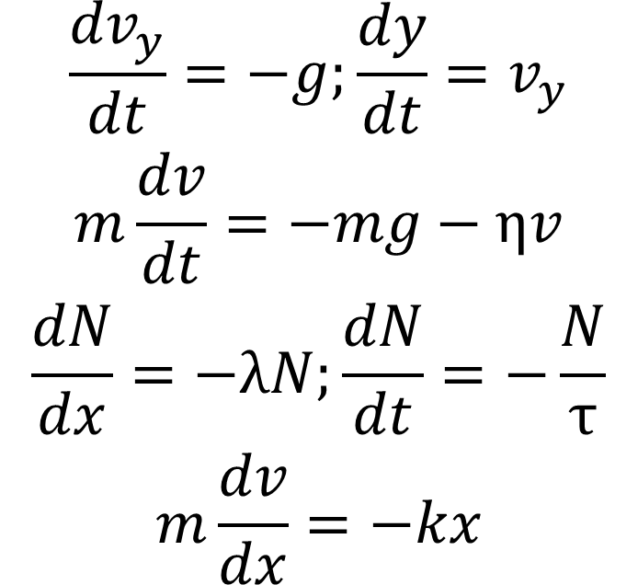
Example of first order differential equation commonly encountered in physics
Do you recognize these equations?
$$\begin{matrix}\frac{{dv}_{y}}{dt}=−g;\frac{dy}{dt}=v_{y} \\ m\frac{dv}{dt}=−mg−ηv \\ \frac{dN}{dx}=−λN;\frac{dN}{dt}=−\frac{N}{τ} \\ m\frac{dv}{dx}=−kx\end{matrix}$$

Slide 3
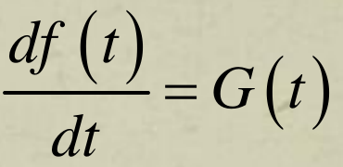
General form of first order differential equations
dN(t)/dt = -N(t) /τ
G(t)≡-N(t)/τ
f(t) ≡ N(t)
dv(x)/dx = -(k/m)x
t ≡ x
d/dt ≡ d/dx
G(t)≡-(k/m)x
f(t) ≡ v(x)
dv(t)/dt = -g-ηv(t)/m
G(t)≡-g-ηv(t)/m
f(t) ≡ v(t)

Slide 4
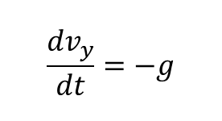
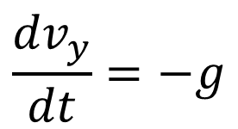

Analytical solution of
$$\frac{{dv}_{y}}{dt}=−g$$
ZCA 101 mechanics, kinematic equation for a free fall object
What is the solution, i.e., v_{y}=v_{y}(t)?
$$\frac{{dv}_{y}}{dt}=−g$$
$$\begin{matrix}\frac{{dv}_{y}}{dt}=−g \\ ⇒\int{\frac{{dv}_{y}}{dt}}dt=−\int{g}dt \\ \int{{dv}_{y}}=v_{y}=−\int{g}dt=−gt+c \\ ⇒v_{y}=v_{y}\left(t\right)=−gt+c\end{matrix}$$

Slide 5

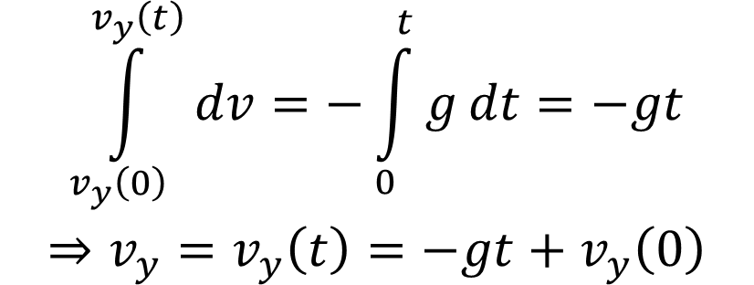
Analytical solution of
$$\frac{{dv}_{y}}{dt}=−g$$
To completely solve this first order differential equation, i.e., to determine v_{y} as a function of t, and the arbitrary constant c, a boundary value or initial value of v_{y} at a given time t is necessary. Usually (but not necessarily) v_{y}(0), i.e., the value of v_{y} at t=0 has to be assumed.
$$\frac{{dv}_{y}}{dt}=−g$$
$$\begin{matrix}\int_{v_{y}\left(0\right)}^{v_{y}\left(t\right)}{dv}=−\int_{0}^{t}{g}dt=−gt \\ ⇒v_{y}=v_{y}\left(t\right)=−gt+v_{y}\left(0\right)\end{matrix}$$

Slide 6


Analytical solution of
$$\frac{dy}{dt}=v_{y}$$
Assume v_{y}=v_{y}(t) a known function of t.
To completely solve the equation so that we can know what is the function y(t), we need to know the value of y(0).
$$\begin{matrix}\int_{y\left(0\right)}^{y\left(t\right)}{dy}=\int_{0}^{t}{v_{y}}dt \\ ⇒y\left(t\right)−y\left(0\right)=\int_{0}^{t}{v_{y}}dt\end{matrix}$$

Slide 7

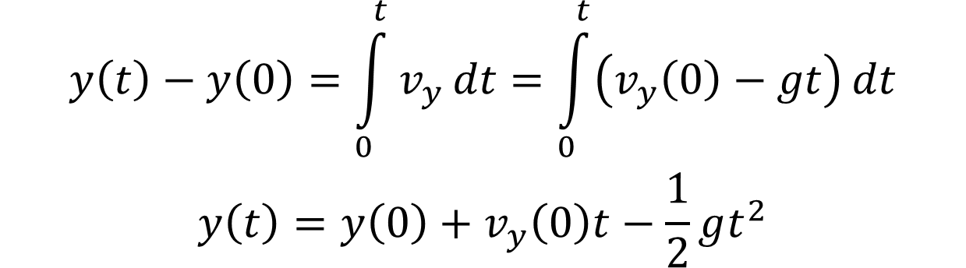
Analytical solution of
$$\frac{dy}{dt}=v_{y}$$
In free fall without drag force, v_{y}(t)=v_{y}(0)-gt.
The complete solution takes the form
$$\begin{matrix}y\left(t\right)−y\left(0\right)=\int_{0}^{t}{v_{y}}dt=\int_{0}^{t}{\left(v_{y}\left(0\right)−gt\right)}dt \\ y\left(t\right)=y\left(0\right)+v_{y}\left(0\right)t−\frac{1}{2}gt^{2}\end{matrix}$$

Slide 8
Boundary condition
In general, to completely solve a first order differential equation for a function with single variable, a boundary condition value must be provided.
Generalising such argument, two boundary condition values must be supplied in order to completely solve a second order differential equation.
n boundary condition values must be supplied in order to completely solve a n-th order differential equation.
Hence, supplying boundary condition values are necessary when numerically solving a differential equation.

Slide 9
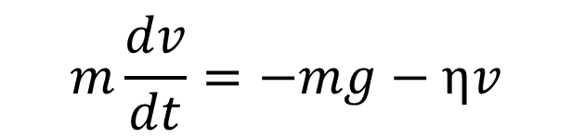
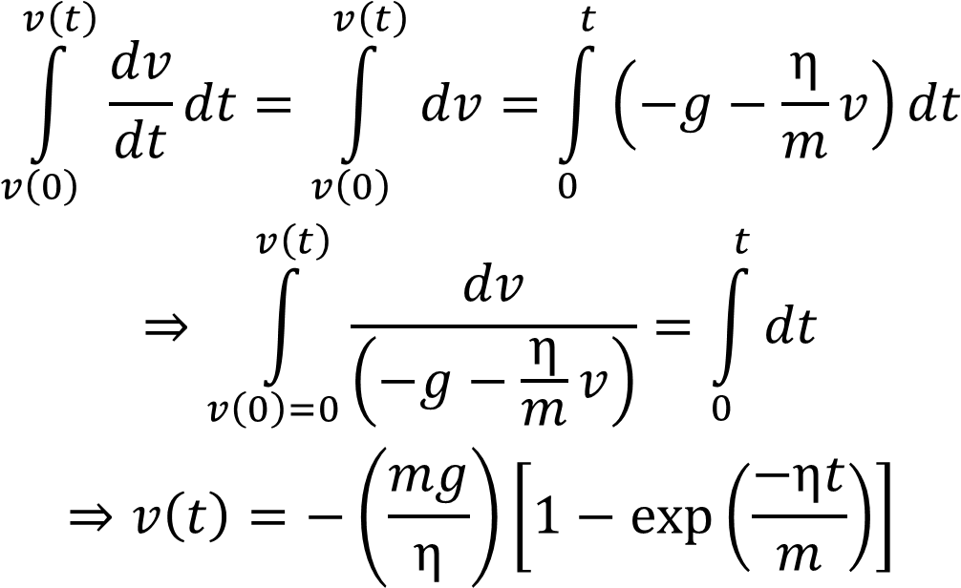
Analytical solution of a free fall object in a viscous medium
$$m\frac{dv}{dt}=−mg−ηv$$
Boundary condition: v=0 at t = 0.
$$\begin{matrix}\int_{v\left(0\right)}^{v\left(t\right)}{\frac{dv}{dt}}dt=\int_{v\left(0\right)}^{v\left(t\right)}{dv}=\int_{0}^{t}{\left(−g−\frac{η}{m}v\right)}dt \\ ⇒\int_{v\left(0\right)=0}^{v\left(t\right)}{\frac{dv}{\left(−g−\frac{η}{m}v\right)}}=\int_{0}^{t}{dt} \\ ⇒v\left(t\right)=−\left(\frac{mg}{η}\right)\left[1−exp\left(\frac{−ηt}{m}\right)\right]\end{matrix}$$

Slide 10
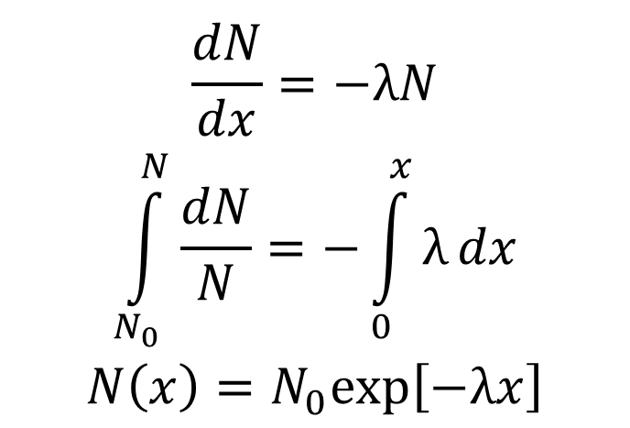
Number of beta particles penetrating a medium (recall your first year lab experiments)
$$\begin{matrix}\frac{dN}{dx}=−λN \\ \int_{N_{0}}^{N}{\frac{dN}{N}}=−\int_{0}^{x}{λ}dx \\ N\left(x\right)=N_{0}exp\left[−λx\right]\end{matrix}$$

Slide 11
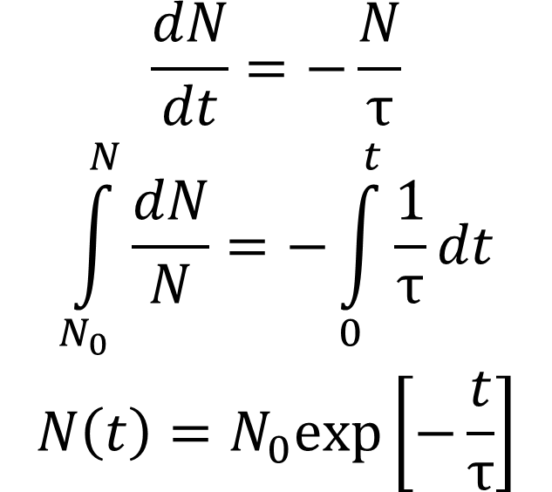
Number of radioactive particle remained after time t (recall your first year lab experiments. τ: half-life)
$$\begin{matrix}\frac{dN}{dt}=−\frac{N}{τ} \\ \int_{N_{0}}^{N}{\frac{dN}{N}}=−\int_{0}^{t}{\frac{1}{τ}}dt \\ N\left(t\right)=N_{0}exp\left[−\frac{t}{τ}\right]\end{matrix}$$

Slide 12
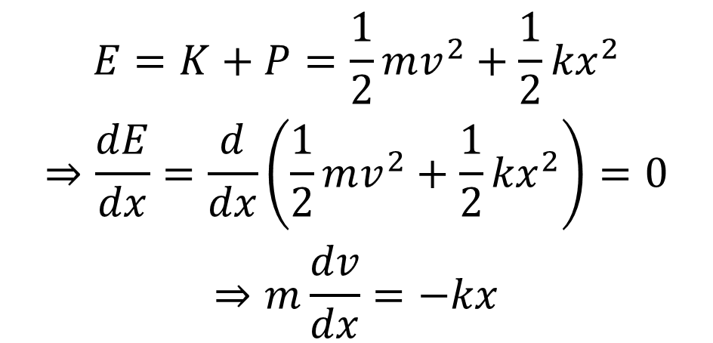
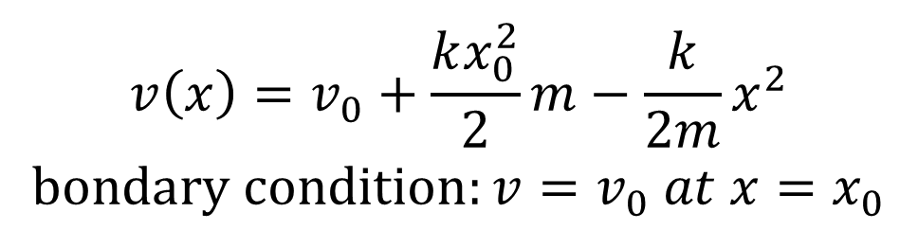
Relation of speed vs. displacement in SHM
$$\begin{matrix}E=K+P=\frac{1}{2}mv^{2}+\frac{1}{2}{kx}^{2} \\ ⇒\frac{dE}{dx}=\frac{d}{dx}\left(\frac{1}{2}mv^{2}+\frac{1}{2}{kx}^{2}\right)=0 \\ ⇒m\frac{dv}{dx}=−kx\end{matrix}$$
The solution is
$$\begin{matrix}v\left(x\right)=v_{0}+\frac{kx_{0}^{2}}{2}m−\frac{k}{2m}x^{2} \\ bondary condition:v=v_{0} at x=x_{0}\end{matrix}$$

Slide 13
DSolve and NDSolve
Now, we would learn how to solve these first order differential equations
DSolve[] (symbolically)
and
NDSolve[] (numerically)
Sample codes:
C7_NSolve_example.nb
C7_NDSolve_example.nb

Slide 14
Now, how would you write your own algorithm to solve first order differential equations numerically?

Slide 15
Euler’s method for discreteising a first order differential equation into a difference equation

Slide 16
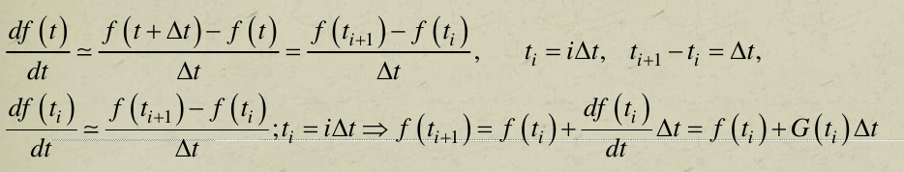
Discretising the differential equation
In Euler method, where the differentiation of a function at time t is approximated as

Slide 17
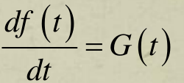
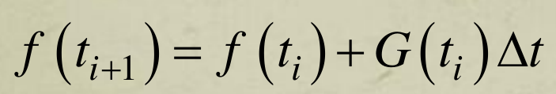
Essentially, Euler's method says
Differential equation
Discretise
Difference equation
Boundary condition:
the numerical value at f(t₀) has to be supplied.

Slide 18
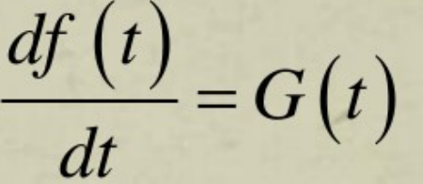

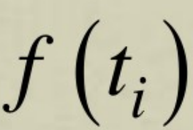
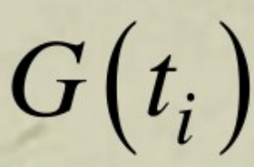
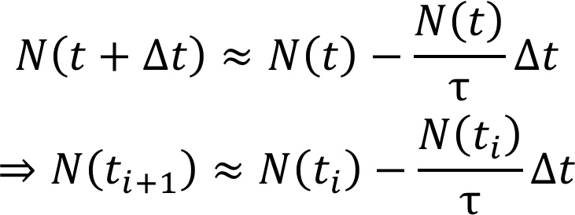
Discretising the differential equation dN(t)/dt = -N(t) /τ
c.f
dN(t)/dt = -N(t) /τ is discretised into a difference equation,
which is suitable for numerical manipulation using computer.
There are many different way to discretise a differential equation.
Euler's method is just among the easiest of them.
$$\begin{matrix}N\left(t+Δt\right)≈N\left(t\right)−\frac{N\left(t\right)}{τ}Δt \\ ⇒N\left(t_{i+1}\right)≈N\left(t_{i}\right)−\frac{N\left(t_{i}\right)}{τ}Δt\end{matrix}$$
c.f

Slide 19

The code’s structure
$$\frac{dN}{dt}=−\frac{N}{τ}$$
Initialisation:
Assign (i) N (t=0), τ, (ii) Number of steps, Nstep, (iii) Time when to stop, say tfinal= 10τ.
The global error is of the order O ~ Δt
Δt = tfinal/Nstep
In principle, the finer the time interval Δt is, the numerical solution becomes more accurate.
t_{i}=t₀+iΔt ; i=0,1,2,...,tfinal
Calculate N (t₁)= N (t₀)- Δt N (t₀)/τ.
Then calculate N (t₂)= N (t₁)- Δt N (t₁)/τ
N (t₃)= N (t₂)- Δt N (t₂)/τ, ...
Stop when t = tfinal.
Plot the output: N (t ) as function of t.
Sample code: C7_Euler_nucleidecay.nb

Slide 20

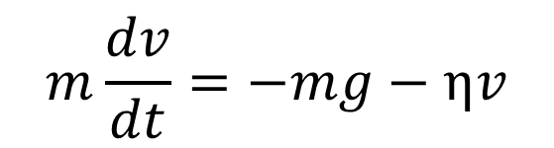
Exercise
Develop your own version of Euler method to solve
Note that your code must handle the boundary condition properly.
Also use Dsolve[] to generate the analytical solutions. Overlap the analytical solution on top of the numerical solutions using Euler method to show that you have obtained the correct result.
$$m\frac{dv}{dt}=−mg−ηv$$
$$m\frac{dv}{dx}=−kx$$

Slide 21

Sample Euler codes
$$\begin{matrix} \\ m\frac{dv}{dt}=−mg−ηv \\ m\frac{dv}{dx}=−kx \\ \end{matrix}$$
C7_Euler_freefall_dragforce.nb
C7_Euler_SHM_v_vs_x.nb

