Slide 1
Chapter 8
Solving Second order differential equations numerically

Slide 2
Online lecture materials
The online lecture notes by Dr. Tai-Ran Hsu of San José State University,
http://www.engr.sjsu.edu/trhsu/Chapter%204%20Second%20order%20DEs.pdf
provides a very clear explanation of the solutions and applications of some typical second order differential equations.

Slide 3

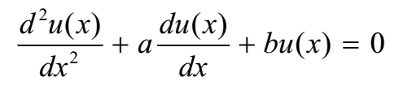

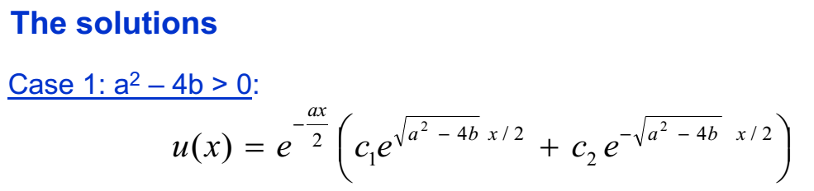
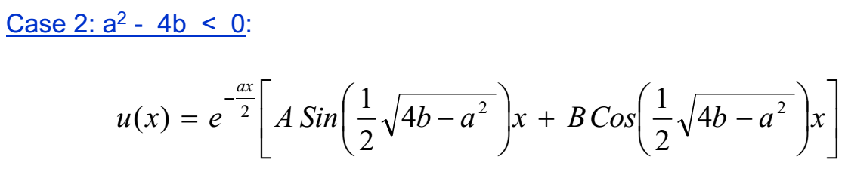

Slide 4
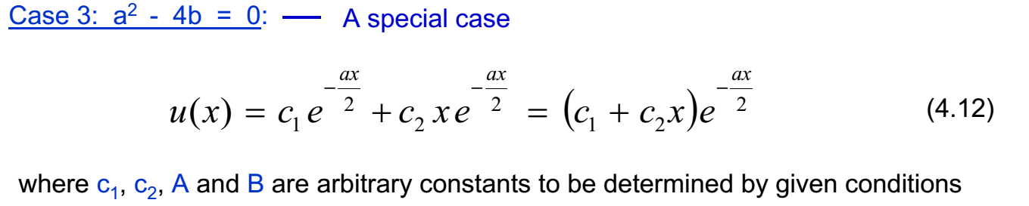

Slide 5
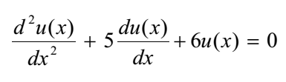

Slide 6


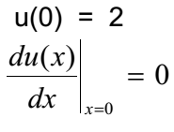


Slide 7
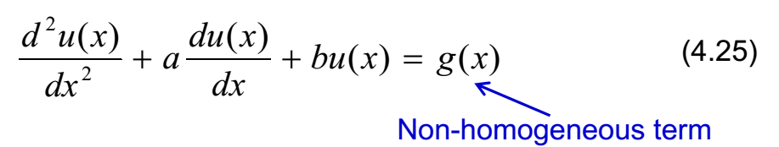
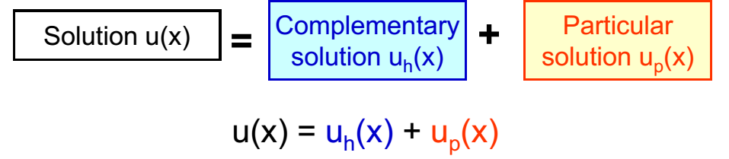
Typical second order, non-homogeneous ordinary differential equations
n(x)

Slide 8


Typical second order, non-homogeneous ordinary differential equations
n(x)

Slide 9

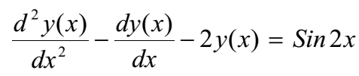




Guess:
After some algebra

Slide 10

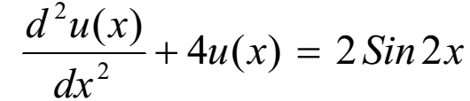
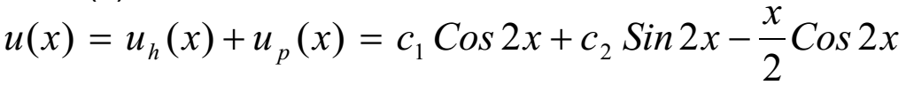

Slide 11

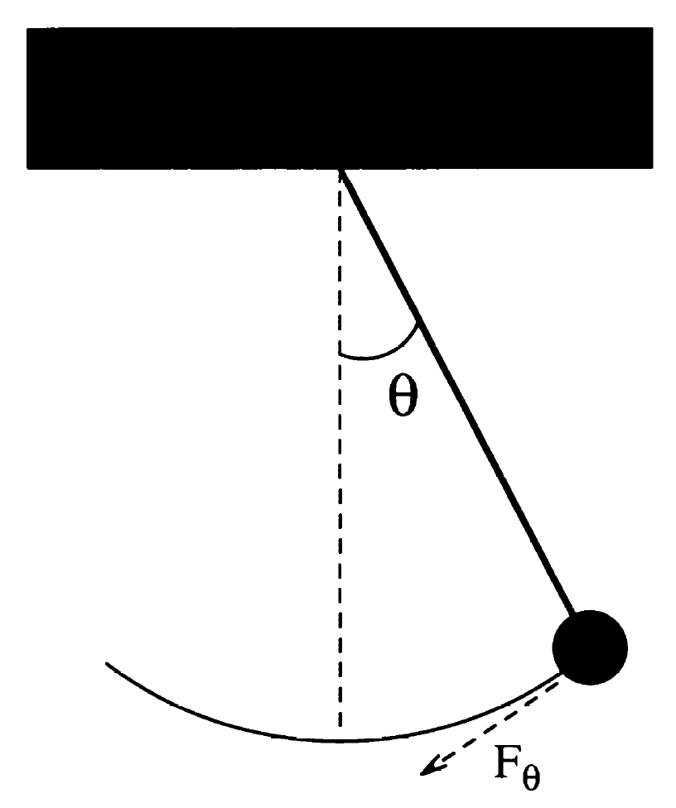
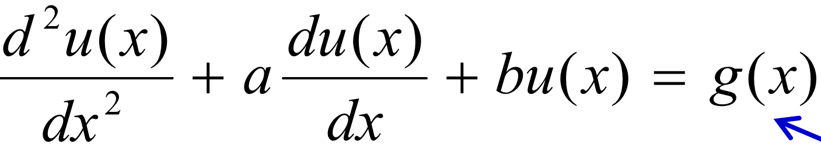

Simple Harmonic pendulum as a special case of second order DE
Force on the pendulum
for small oscillation,
Equation of motion (EoM)
$$F_{θ}=ma_{θ}$$
$−mgsinθ$=$m\frac{dv_{θ}}{dt}=m\frac{d}{dt}\left(\frac{dr}{dt}\right)≈m\frac{d^{2}}{{dt}^{2}}\left(lθ\right)$
$$\frac{d^{2}θ}{{dt}^{2}}≈−\frac{gθ}{l}$$
l
r
The period of the SHO is given by
n(x)
Notes:
11

Slide 12
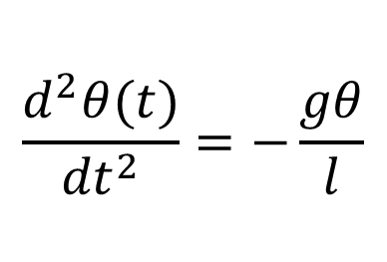
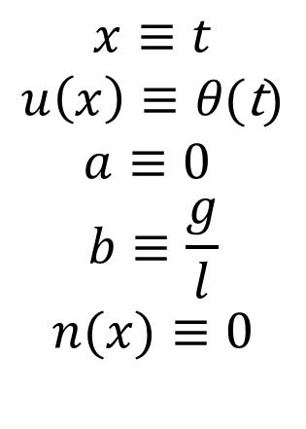
Simple Harmonic pendulum as a special case of second order DE (cont.)
n(x)
$$x≡t$$
$$u\left(x\right)≡θ\text{(}\text{t}\text{)}$$
$$a≡0$$
$$b≡\frac{g}{l}$$
$$n(x)≡0$$
$$\frac{d^{2}θ(t)}{{dt}^{2}}=−\frac{gθ}{l}$$
Notes:
12

Slide 13
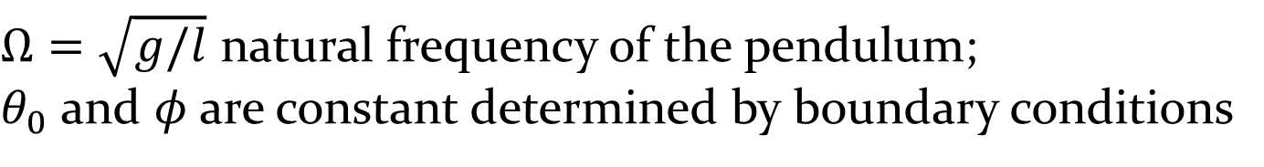
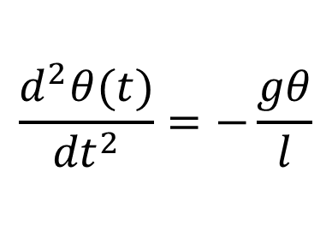
Simple Harmonic pendulum as a special case of second order DE (cont.)
$$\frac{d^{2}θ(t)}{{dt}^{2}}=−\frac{gθ}{l}$$
Analytical solution:
$Ω=\sqrt{g/l}$ natural frequency of the pendulum;
$θ_{0}$ and $φ$are constant determined by boundary conditions
Notes:
13

Slide 14
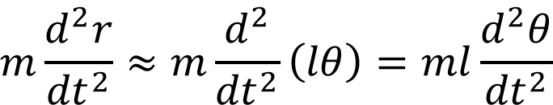
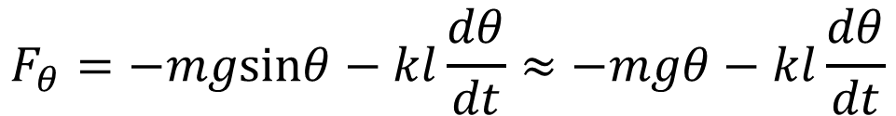
Simple Harmonic pendulum with drag force as a special case of second order DE
Drag force on a moving object, f_{d} = - kv
For a pendulum, instantaneous velocity
v = ωl = l (dθ/dt)
Hence, f_{d} = - kl (dθ/dt).
Consider the net force on the forced pendulum along the tangential direction, in the θ → 0 limit:
l
f_{d}
$$F_{θ}=−mgsinθ−kl\frac{dθ}{dt}≈−mgθ−kl\frac{dθ}{dt}$$
r
v
$$m\frac{d^{2}r}{{dt}^{2}}≈m\frac{d^{2}}{{dt}^{2}}\left(lθ\right)=ml\frac{d^{2}θ}{{dt}^{2}}$$
mg
$$F_{θ}=m\frac{d^{2}r}{{dt}^{2}}⇒\frac{d^{2}θ}{{dt}^{2}}=−\frac{g}{l}θ−\frac{k}{m}\frac{dθ}{dt}≡−\frac{g}{l}θ−q\frac{dθ}{dt};q≡\frac{k}{m}$$
Notes:
14

Slide 15
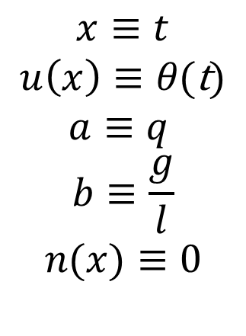
Simple Harmonic pendulum with drag force as a special case of second order DE (cont.)
n(x)
$$x≡t$$
$$u\left(x\right)≡θ\text{(}\text{t}\text{)}$$
$$a≡q$$
$$b≡\frac{g}{l}$$
$$n(x)≡0$$
l
l
f_{d}
r
r
v
mg
Notes:
15

Slide 16
Analytical solutions
1. Underdamped regime (small damping). Still oscillate, but amplitude decay slowly over many period before dying totally.

Slide 17
Analytical solutions
2. Overdamped regime (very large damping), decay slowly over several period before dying totally. θ is dominated by exponential term.

Slide 18
Analytical solutions
3. Critically damped regime, intermediate between under- and overdamping case.

Slide 19
Overdamped
Critically damped
Underdamped

Slide 20
See C8_2ODE_Pendulum.nb where Dsolve[] solves the three cases of a damped pendulum analytically.

Slide 21



Adding driving force to the damped oscillator: forced oscillator
Ω_{D} frequency of the applied force
- kl (dθ/dt) + F_{D} sin(Ω_{D}t)
$$m\frac{d^{2}r}{{dt}^{2}}$$
$$m\frac{d^{2}r}{{dt}^{2}}$$
$$≈$$

Slide 22
Analytical solution
Resonance happens when

Slide 23
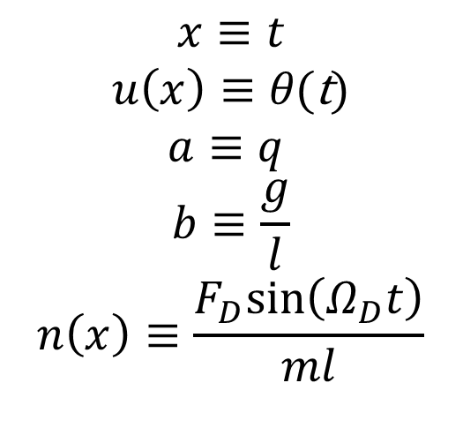
Forced oscillator: An example of non homogeneous 2nd order DE
n(x)
$$x≡t$$
$$u\left(x\right)≡θ\text{(}\text{t}\text{)}$$
$$a≡q$$
$$b≡\frac{g}{l}$$
$$n\left(x\right)≡\frac{F_{D}sin\left(Ω_{D}t\right)}{ml}$$

Slide 24
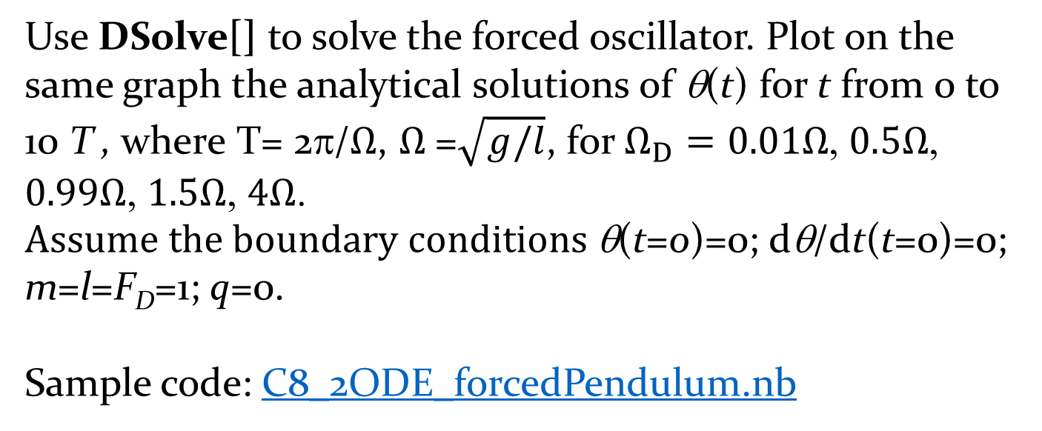
Exercise: Forced oscillator
Use DSolve[] to solve the forced oscillator. Plot on the same graph the analytical solutions of θ(t) for t from 0 to 10 T , where T= 2π/$Ω$, $Ω$=$\sqrt{g/l}$, for $Ω_{D}=0.01Ω$, $0.5Ω$, $0.99Ω$, $1.5Ω$, $4Ω$. $Assume the boundary conditions$θ(t=0)=0; dθ/dt(t=0)=0; m=l=F_{D}=1; q=0.
Sample code: C8_2ODE_forcedPendulum.nb

Slide 25
Second order Runge-Kutta (RK2) method
Consider a generic second order differential equation.
It can be numerically solved using second order Runge-Kutta method.
Split the second order DE into two first order parts:

Slide 26
Algorithm
Set boundary conditions: u(x=x₀)=u₀, u’(x=x₀)=v(x=x₀)=v₀.
calculate
calculate
calculate
calculate

Slide 27

Translating the SK2 algorithm into the case of simple pendulum
$$\frac{d^{2}θ(t)}{{dt}^{2}}=−\frac{gθ}{l}$$
Set boundary conditions:
u(x=x₀)=u₀, u’(x=x₀)=v(x=x₀)=v₀
Set boundary conditions:
θ(t=t₀)= θ₀, θ’ (t=t₀)=ω(t=t₀)=ω₀

Slide 28
Exercise: Develop a code to implement SK2 for the case of the simple pendulum. Boundary conditions:
See C8_pendulum_RK2.nb

Slide 29

Translating the SK2 algorithm into the case of damped pendulum
$$\frac{d^{2}θ(t)}{{dt}^{2}}=−\frac{gθ}{l}−q\frac{dθ}{dt}$$
Set boundary conditions:
u(x=x₀)=u₀, u’(x=x₀)=v(x=x₀)=v₀
Set boundary conditions:
θ(t=t₀)= θ₀, θ’ (t=t₀)=ω(t=t₀)=ω₀

Slide 30
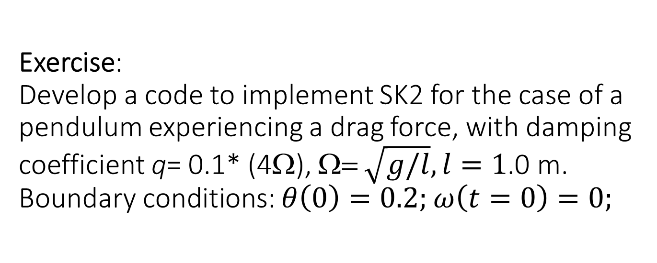
Exercise:
Develop a code to implement SK2 for the case of a pendulum experiencing a drag force, with damping coefficient q= 0.1* (4Ω), Ω= $\sqrt{g/l}, l=1$.0 m. Boundary conditions: $θ\left(0\right)=0.2;$ $ω\left(t=0\right)=0;$
Sample code: C8_dampedpendulum_RK2.nb

Slide 31
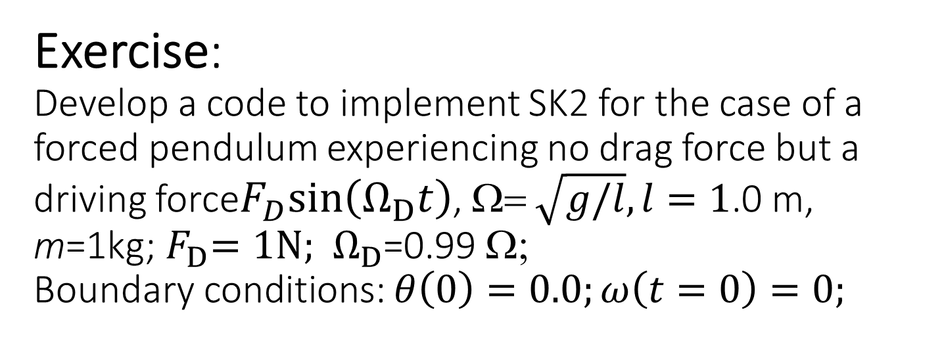
Exercise:
Develop a code to implement SK2 for the case of a forced pendulum experiencing no drag force but a driving force$F_{D}sin\left(Ω_{D}t\right)$, Ω= $\sqrt{g/l},l=1$.0 m, m=1kg;${ F}_{D}=1N;{ Ω}_{D}$=0.99 Ω;
Boundary conditions: $θ\left(0\right)=0.0;ω\left(t=0\right)=0;$

Slide 32
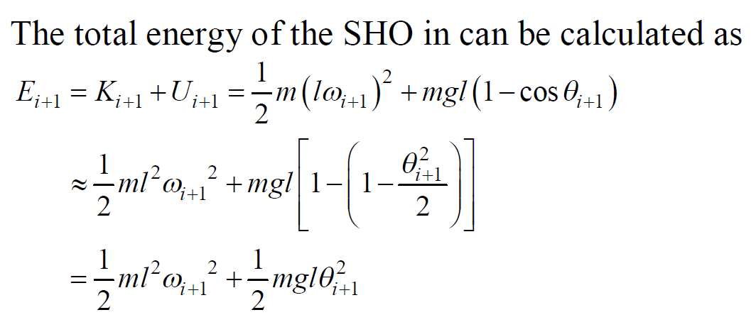
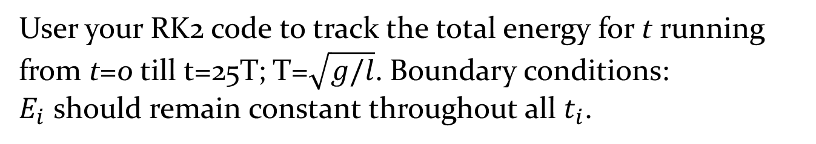
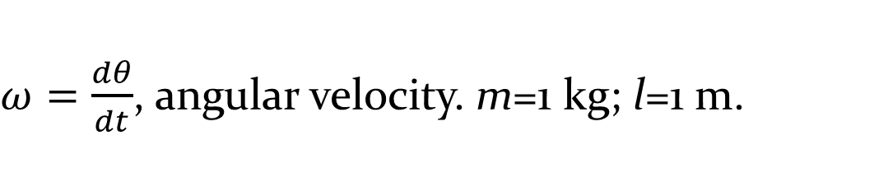
Exercise: Stability of the total energy a SHO in RK2.
$ω=\frac{dθ}{dt}$, angular velocity. m=1 kg; l=1 m.
User your RK2 code to track the total energy for t running from t=0 till t=25T; T=$\sqrt{g/l}$. Boundary conditions:
$E_{i}$ should remain constant throughout all $t_{i}$.

