Slide 1
Chapter 9
Solving Second order differential equations numerically, 2

Slide 2
Online lecture materials
The online lecture notes by Dr. Tai-Ran Hsu of San José State University,
http://www.engr.sjsu.edu/trhsu/Chapter%204%20Second%20order%20DEs.pdf
provides a very clear explanation of the solutions and applications of some typical second order differential equations.

Slide 3

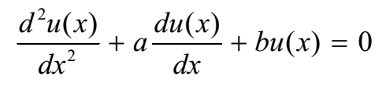

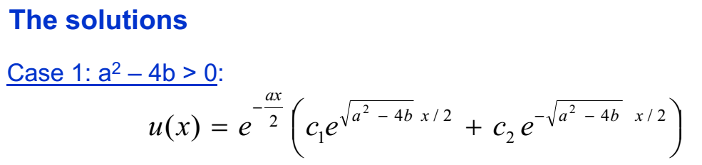
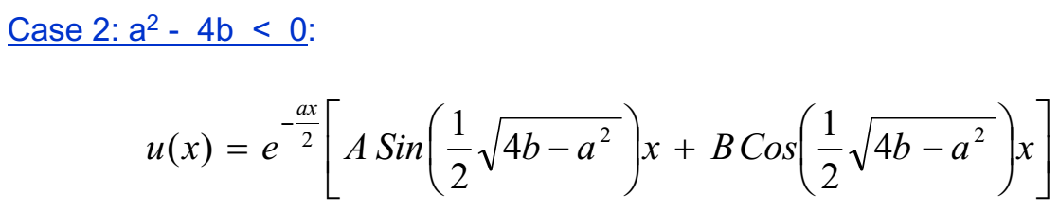

Slide 4
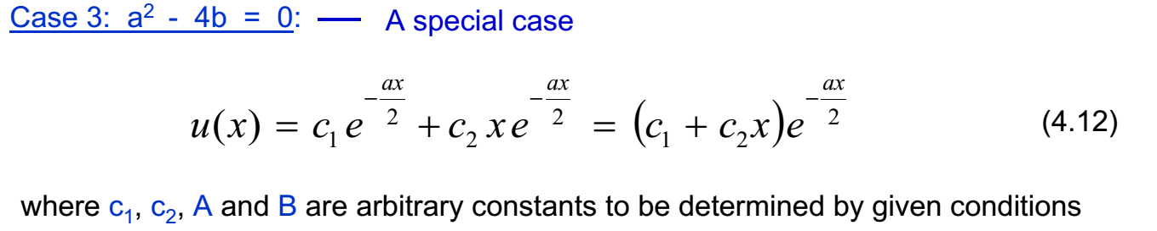

Slide 5
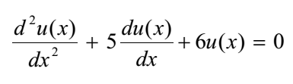

Slide 6


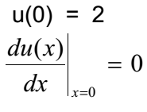


Slide 7
DSolve
DSolve of Mathematica can provide analytical solution to a generic second order differential equation. See Math_built_in_2ODE.nb.

Slide 8
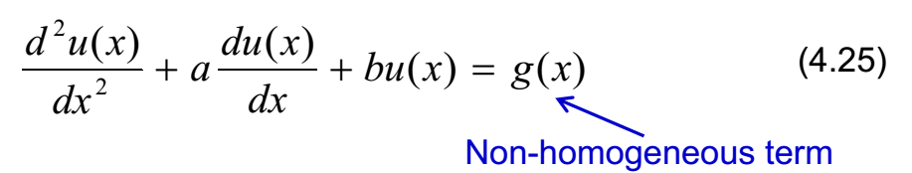
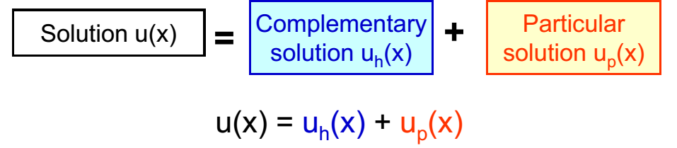
Typical second order, non-homogeneous ordinary differential equations
n(x)

Slide 9


Typical second order, non-homogeneous ordinary differential equations
n(x)

Slide 10

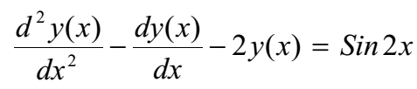




Guess:
After some algebra

Slide 11

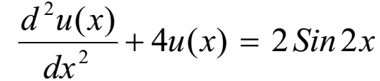
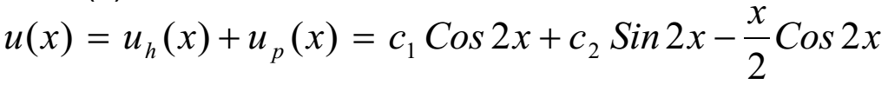

Slide 12

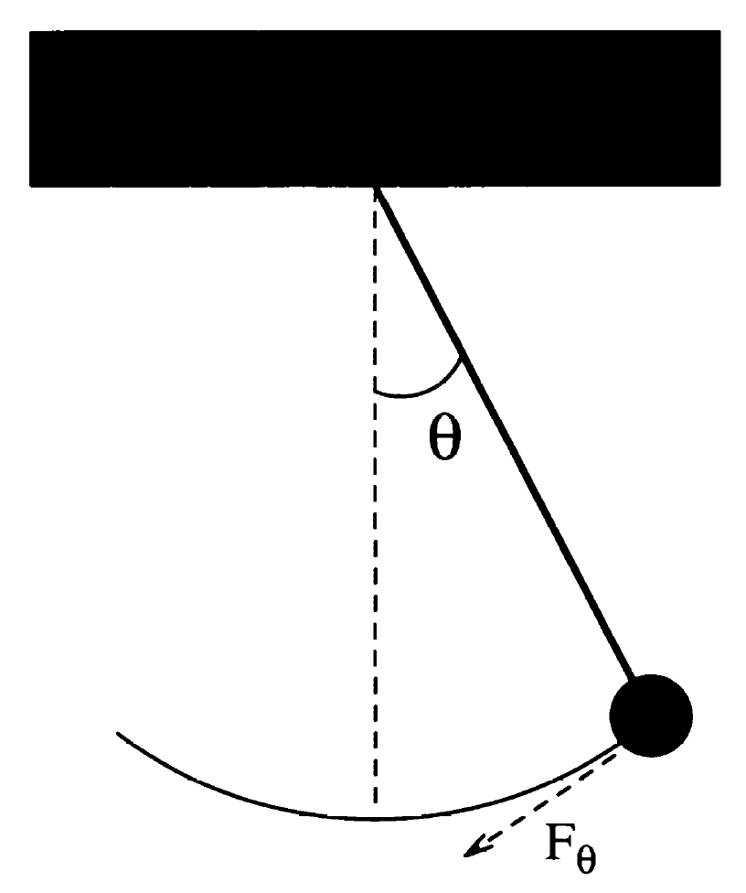
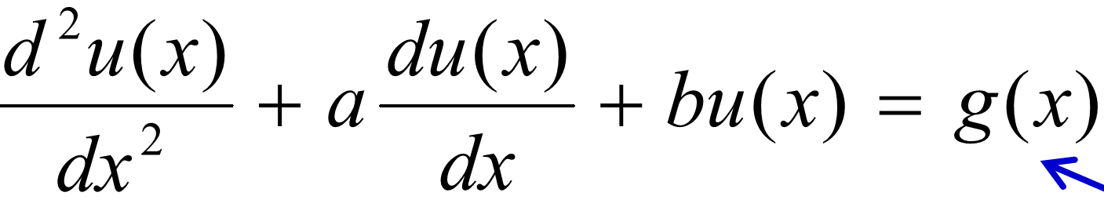

Simple Harmonic pendulum as a special case of second order DE
Force on the pendulum
for small oscillation,
Equation of motion (EoM)
$$F_{θ}=ma_{θ}$$
$−mgsinθ$=$m\frac{dv_{θ}}{dt}=m\frac{d}{dt}\left(\frac{dr}{dt}\right)≈m\frac{d^{2}}{{dt}^{2}}\left(lθ\right)$
$$\frac{d^{2}θ}{{dt}^{2}}≈−\frac{gθ}{l}$$
l
r
The period of the SHO is given by
n(x)
Notes:
12

Slide 13
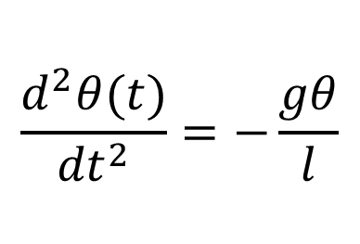
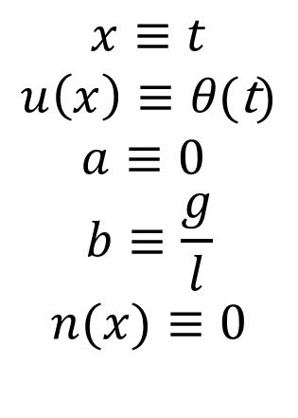
Simple Harmonic pendulum as a special case of second order DE (cont.)
n(x)
$$x≡t$$
$$u\left(x\right)≡θ\text{(}\text{t}\text{)}$$
$$a≡0$$
$$b≡\frac{g}{l}$$
$$n(x)≡0$$
$$\frac{d^{2}θ(t)}{{dt}^{2}}=−\frac{gθ}{l}$$
Notes:
13

Slide 14
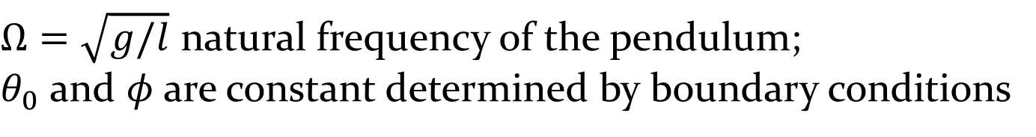
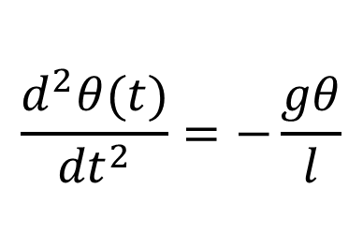
Simple Harmonic pendulum as a special case of second order DE (cont.)
$$\frac{d^{2}θ(t)}{{dt}^{2}}=−\frac{gθ}{l}$$
Analytical solution:
$Ω=\sqrt{g/l}$ natural frequency of the pendulum;
$θ_{0}$ and $φ$are constant determined by boundary conditions
Notes:
14

Slide 15
Simple Harmonic pendulum with drag force as a special case of second order DE
Drag force on a moving object, f_{d} = - kv
For a pendulum, instantaneous velocity v = ωl = l (dθ/dt)
Hence, f_{d} = - kl (dθ/dt).
The net force on the forced pendulum along the tangential direction
l
f_{d}
- kl (dθ/dt).
r
Notes:
15

Slide 16
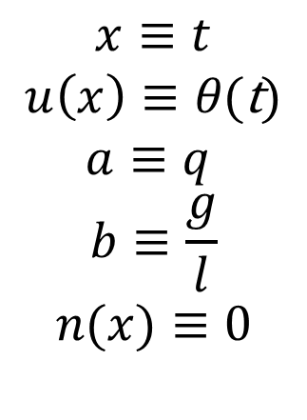
Simple Harmonic pendulum with drag force as a special case of second order DE (cont.)
n(x)
$$x≡t$$
$$u\left(x\right)≡θ\text{(}\text{t}\text{)}$$
$$a≡q$$
$$b≡\frac{g}{l}$$
$$n(x)≡0$$
l
f_{d}
r
Notes:
16

Slide 17
Analytical solution
Underdamped regime (small damping). Still oscillate, but amplitude decay slowly over many period before dying totally.
Overdamped regime (very large damping), decay slowly over several period before dying totally. θ is dominated by exponential term.
Critically damped regime, intermediate between under- and overdamping case.

Slide 18
Overdamped
Critically damped
Underdamped

Slide 19
See 2ODE_Pendulum.nb where DSolve solves the three cases of a damped pendulum analytically.

Slide 20
Adding driving force to the damped oscillator: forced oscillator
Ω_{D} frequency of the applied force
- kl (dθ/dt) + F_{D} sin(Ω_{D}t)

Slide 21
Analytical solution
Resonance happens when

Slide 22
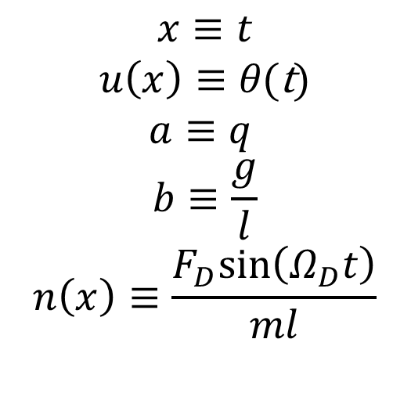
Forced oscillator: An example of non homogeneous 2nd order DE
n(x)
$$x≡t$$
$$u\left(x\right)≡θ\text{(}\text{t}\text{)}$$
$$a≡q$$
$$b≡\frac{g}{l}$$
$$n\left(x\right)≡\frac{F_{D}sin\left(Ω_{D}t\right)}{ml}$$

Slide 23
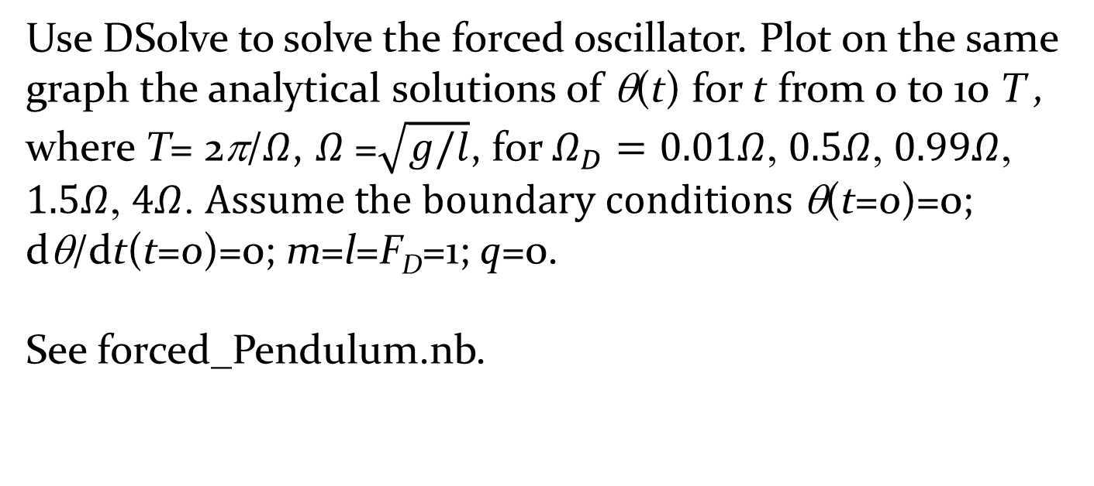
Exercise: Forced oscillator
Use DSolve to solve the forced oscillator. Plot on the same graph the analytical solutions of θ(t) for t from 0 to 10 T , where T= 2π/$Ω$, $Ω$=$\sqrt{g/l}$, for $Ω_{D}=0.01Ω$, $0.5Ω$, $0.99Ω$, $1.5Ω$, $4Ω$. $Assume the boundary conditions$θ(t=0)=0; dθ/dt(t=0)=0; m=l=F_{D}=1; q=0.
See forced_Pendulum.nb.

Slide 24
Second order Runge-Kutta (RK2) method
Consider a generic second order differential equation.
It can be numerically solved using second order Runge-Kutta method. First, split the second order DE into two first order parts:

Slide 25
Algorithm
Set boundary conditions: u(x=x₀)=u₀, u’(x=x₀)=v(x=x₀)=v₀.
calculate
calculate
calculate
calculate

Slide 26

Translating the SK2 algorithm into the case of simple pendulum
$$\frac{d^{2}θ(t)}{{dt}^{2}}=−\frac{gθ}{l}$$
Set boundary conditions:
u(x=x₀)=u₀, u’(x=x₀)=v(x=x₀)=v₀
Set boundary conditions:
θ(t=t₀)= θ₀, θ’ (t=t₀)=ω(t=t₀)=ω₀

Slide 27
Exercise: Develop a code to implement SK2 for the case of the simple pendulum. Boundary conditions:
See pendulum_RK2.nb

Slide 28

Translating the SK2 algorithm into the case of damped pendulum
$$\frac{d^{2}θ(t)}{{dt}^{2}}=−\frac{gθ}{l}−q\frac{dθ}{dt}$$
Set boundary conditions:
u(x=x₀)=u₀, u’(x=x₀)=v(x=x₀)=v₀
Set boundary conditions:
θ(t=t₀)= θ₀, θ’ (t=t₀)=ω(t=t₀)=ω₀

Slide 29
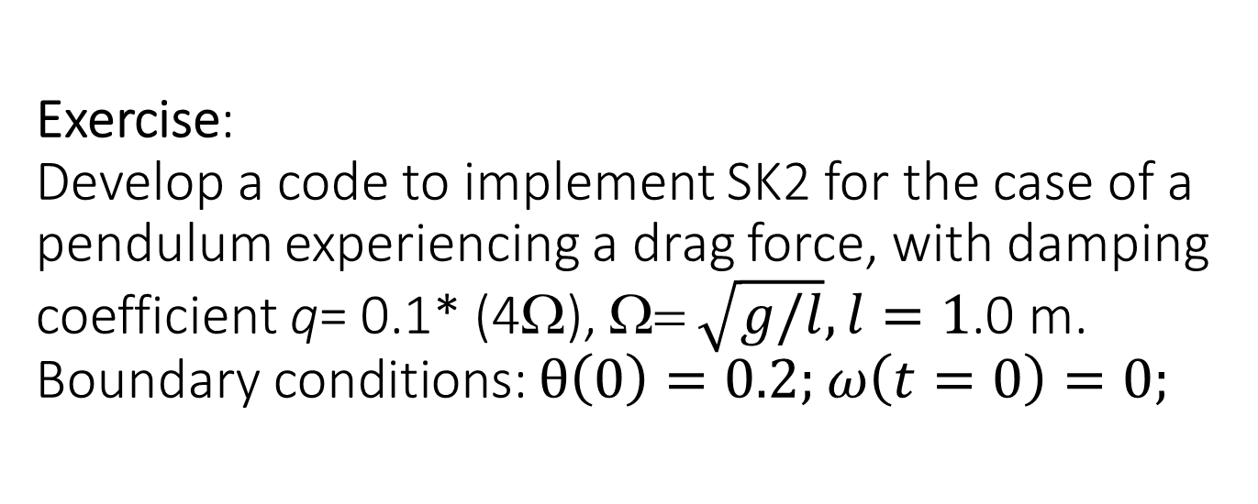
Exercise:
Develop a code to implement SK2 for the case of a pendulum experiencing a drag force, with damping coefficient q= 0.1* (4Ω), Ω= $\sqrt{g/l}, l=1$.0 m. Boundary conditions: $θ\left(0\right)=0.2;$ $ω\left(t=0\right)=0;$
See pendulum_RK2.nb

Slide 30
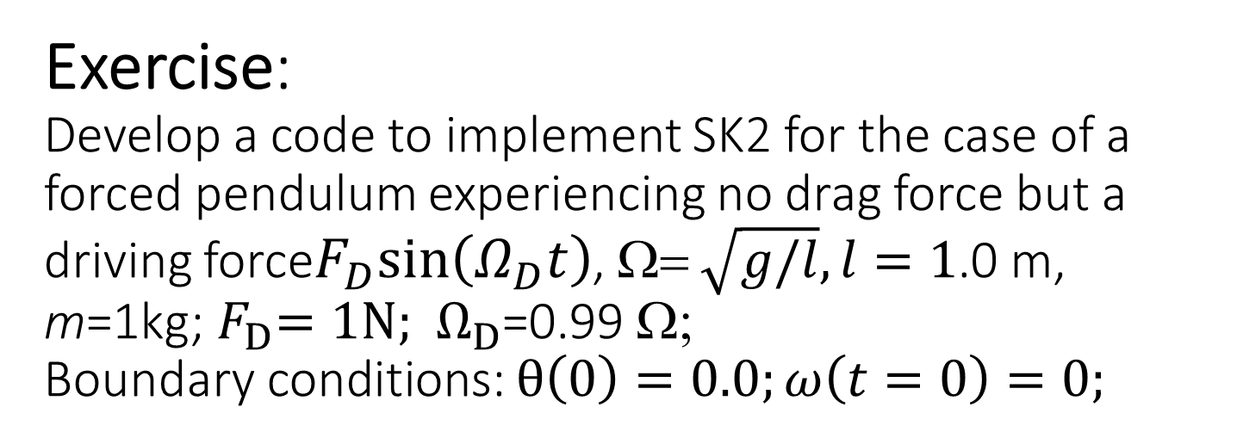
Exercise:
Develop a code to implement SK2 for the case of a forced pendulum experiencing no drag force but a driving force$F_{D}sin\left(Ω_{D}t\right)$, Ω= $\sqrt{g/l},l=1$.0 m, m=1kg;${ F}_{D}=1N;{ Ω}_{D}$=0.99 Ω;
Boundary conditions: $θ\left(0\right)=0.0;ω\left(t=0\right)=0;$

Slide 31
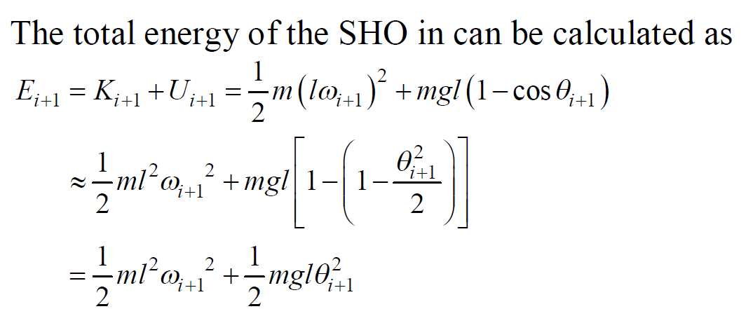
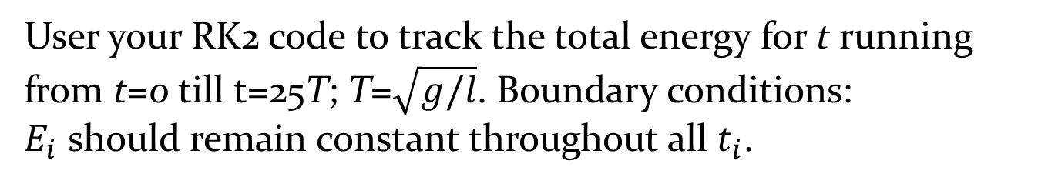
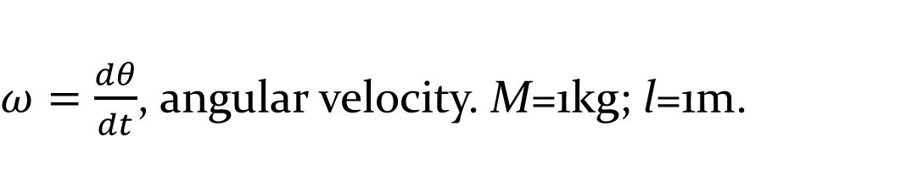
Exercise: Stability of the total energy a SHO in RK2.
$ω=\frac{dθ}{dt}$, angular velocity. M=1kg; l=1m.
User your RK2 code to track the total energy for t running from t=0 till t=25T; T=$\sqrt{g/l}$. Boundary conditions:
$E_{i}$ should remain constant throughout all $t_{i}$.

Slide 32
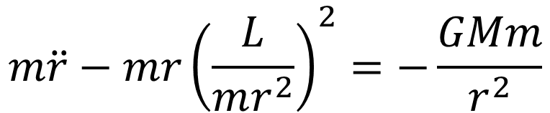
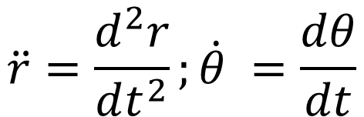

Exercise: Develop a RK2 code for planetary motion in polar coordinates
y
E
S
θ
x
O
$$m\ddot{r}−mr{\left(\frac{L}{mr^{2}}\right)}^{2}=−\frac{GMm}{r^{2}}$$
$$mr^{2}\dot{θ}=L$$
$$\ddot{r}=\frac{d^{2}r}{dt^{2}};\dot{θ} =\frac{dθ}{dt}$$
where

Slide 33
Velocity verlet algorithm for solving the Newton second law

Slide 34
Newton’s second law
Given a position-dependent force acting on a particle, F(r), Newton second law determines the acceleration of a particle, a.
d²r/dt²= F(r)/m
This is a second order differential equation.
Given F(r), we wish to know what are the subsequent evolution of r(t), v(t) beginning from the boundary values of r(0), v(0).
Previously we solve the second order DE using RK2 to obtain r(t), v(t).

Slide 35
Verlet algorithms
The equation d²r/dt²=F(r)/m can be integrated to obtain r(t), v(t), via a numerical scheme: Verlet algoritm
Three types: ordinary Verlet, velocity Verlet, leap frog verlet.
In the following, we shall denote the RHS as
F(r)/m → a
So that d²r/dt²=F(r)/m
↓
d²r/dt²= a
See http://en.wikipedia.org/wiki/Verlet_integration

Slide 36
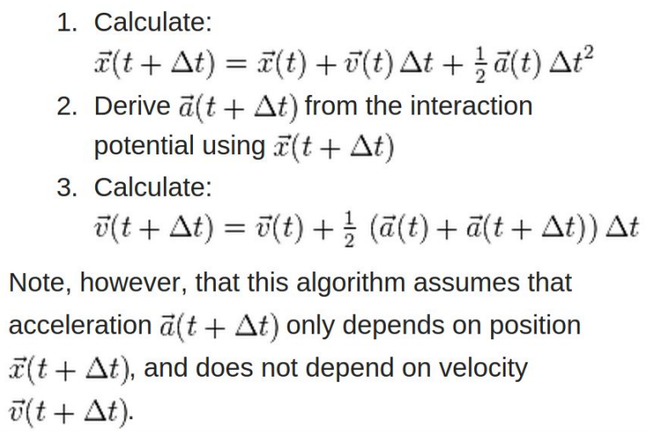
Velocity Verlet algorithm

Slide 37
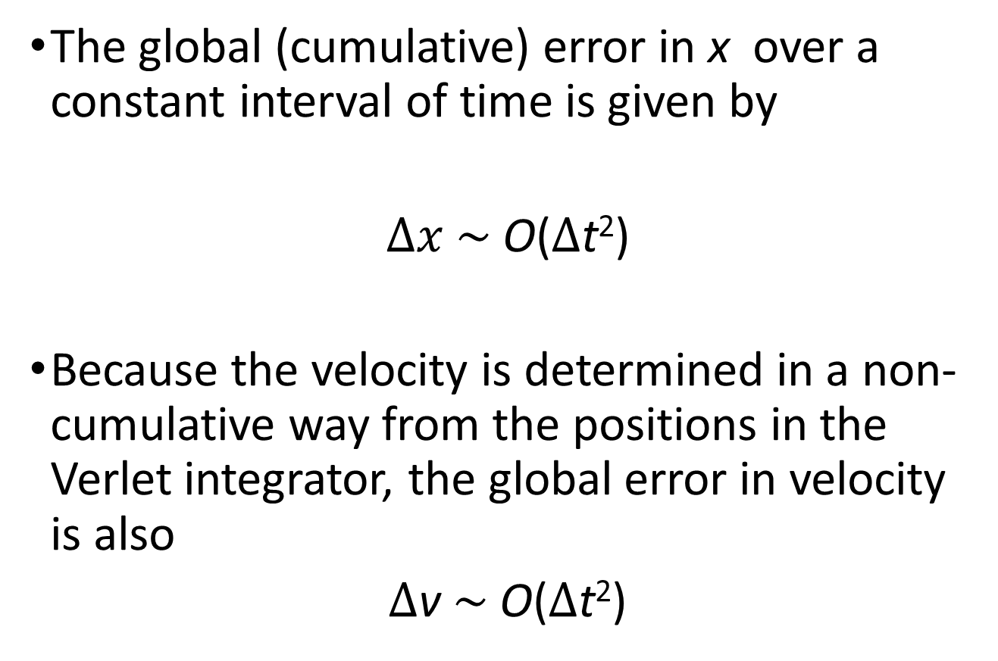
Global error in velocity Verlet algorithm
The global (cumulative) error in x over a constant interval of time is given by
$Δx$ $\sim$ O($Δ$t²)
Because the velocity is determined in a non-cumulative way from the positions in the Verlet integrator, the global error in velocity is also
$Δ$v $\sim$ O($Δ$t²)

Slide 38
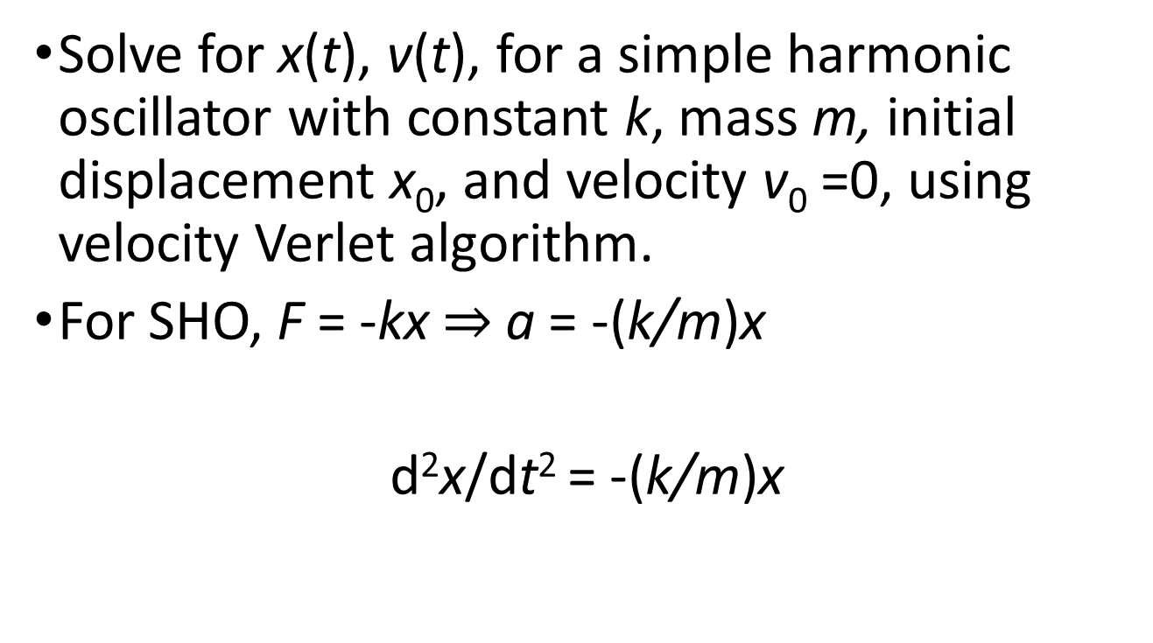
Exercise: SHO
Solve for x(t), v(t), for a simple harmonic oscillator with constant k, mass m, initial displacement x₀, and velocity v₀ =0, using velocity Verlet algorithm.
For SHO, F = -kx $⇒$a = -(k/m)x
d²x/dt² = -(k/m)x
See verlet_algorithm_samples.nb

Slide 39
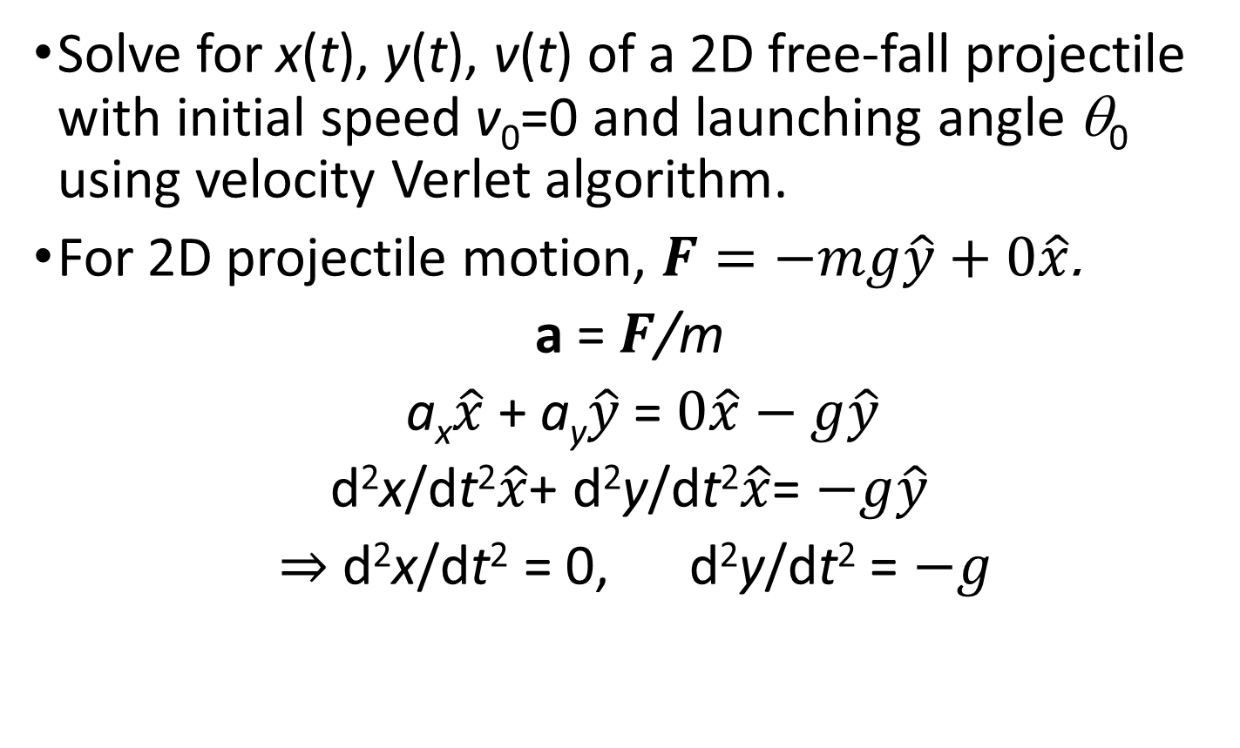
Exercise: 2D free-fall projectile
Solve for x(t), y(t), v(t) of a 2D free-fall projectile with initial speed v₀=0 and launching angle θ₀ using velocity Verlet algorithm.
For 2D projectile motion, $F=−mg\hat{y}+0\hat{x}$.
a = $F$/m
a_{x}$\hat{x}$ + a_{y}$\hat{y}$= $0\hat{x}−g\hat{y}$
d²x/dt²$\hat{x}$+ d²y/dt²$\hat{x}$= $−g\hat{y}$
$⇒$ d²x/dt² = 0, d²y/dt² = $−g$
See verlet_algorithm_samples.nb

Slide 40




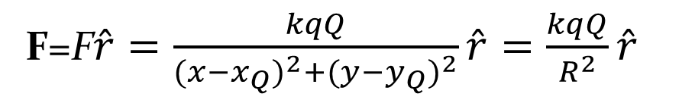
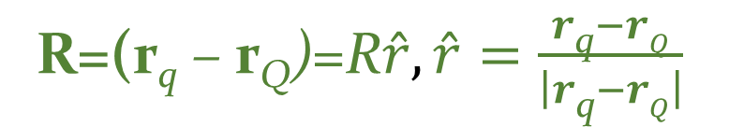
Exercise: Scattering of a projectile charge via Coulomb force
F=F$\hat{r}=\frac{kqQ}{{(x−x_{Q})}^{2}+{(y−y_{Q})}^{2}}\hat{r}=\frac{kqQ}{R^{2}}\hat{r}$
q
$$\hat{y}$$
$$rq=(x,y)$$
(projectile, with mass m)
R=(r_{q} – r_{Q})=R$\hat{r},\hat{r}=\frac{r\text{q}−rQ}{\left|r\text{q}−rQ\right|}$
Q
(Fixed)
$$rQ=\left(xQ,yQ\right)$$
r_{Q}
o
$$\hat{x}$$

Slide 41
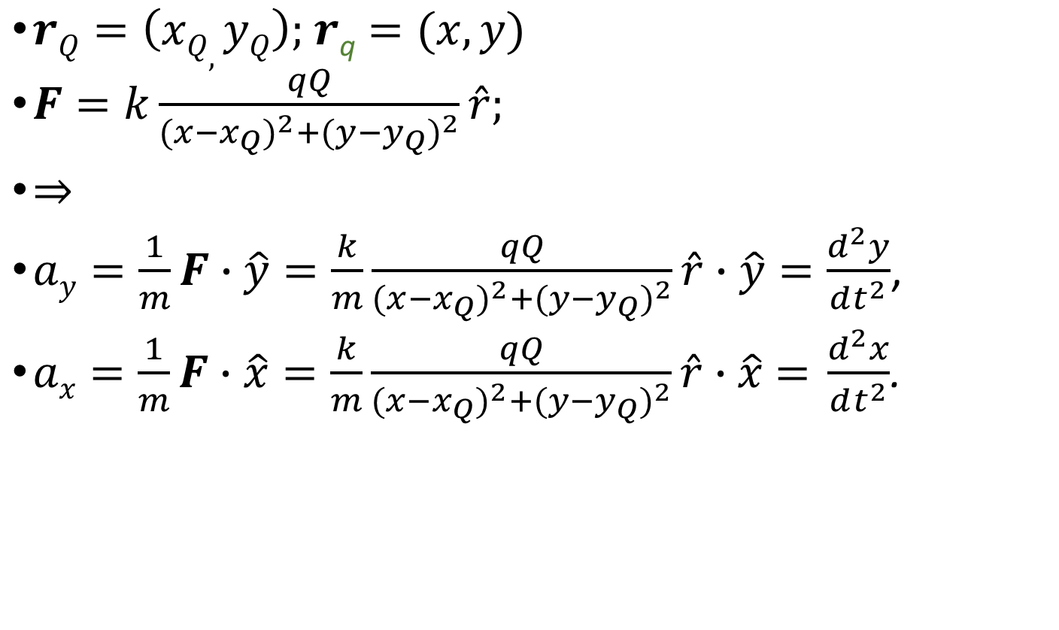
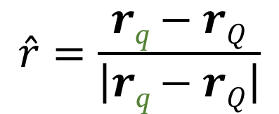
Notation for scattering of a projectile charge via Coulomb force
$rQ=\left(xQ,yQ\right);$ $r\text{q}=(x,y)$
$F=k\frac{qQ}{{(x−x_{Q})}^{2}+{(y−y_{Q})}^{2}}\hat{r};$
$⇒$
$ay=\frac{1}{m}F∙\hat{y}=\frac{k}{m}\frac{qQ}{{(x−x_{Q})}^{2}+{(y−y_{Q})}^{2}}\hat{r}∙\hat{y}=\frac{d^{2}y}{dt^{2}}$,
$ax=\frac{1}{m}F∙\hat{x}=\frac{k}{m}\frac{qQ}{{(x−x_{Q})}^{2}+{(y−y_{Q})}^{2}}\hat{r}∙\hat{x}\text{ = }\frac{d^{2}x}{dt^{2}}$.
$$\hat{r}=\frac{r\text{q}−rQ}{\left|r\text{q}−rQ\right|}$$

Slide 42
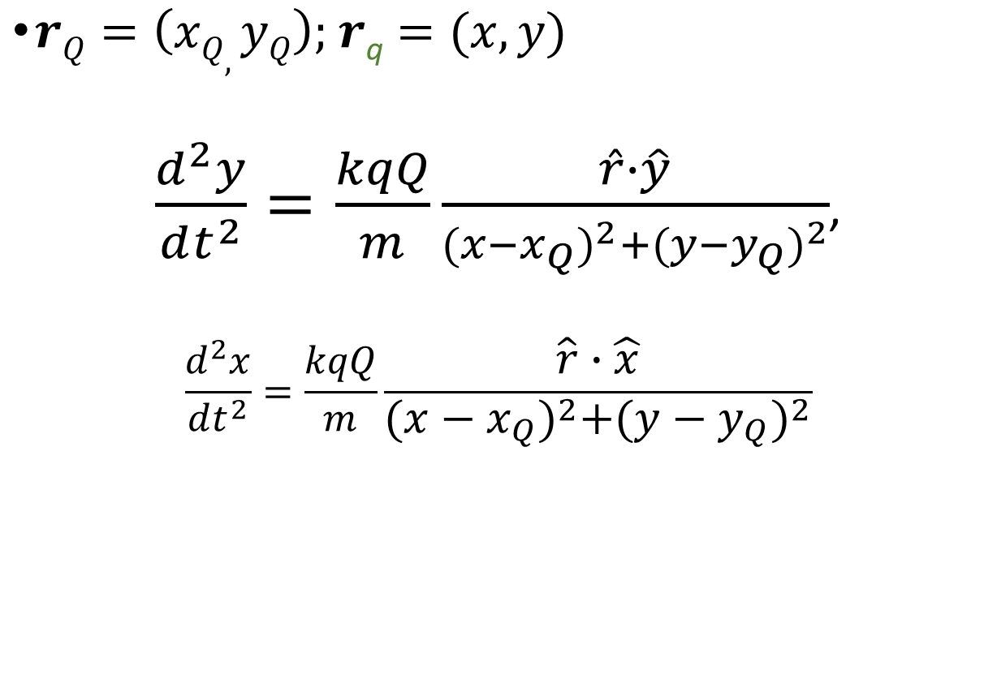

The equations required by Verlet algorithm
$$\hat{r}=\frac{r\text{q}−rQ}{\left|r\text{q}−rQ\right|}$$
$rQ=\left(xQ,yQ\right);$ $r\text{q}=(x,y)$
$\frac{d^{2}y}{dt^{2}}=\frac{kqQ}{m}\frac{\hat{r}∙\hat{y}}{{(x−x_{Q})}^{2}+{(y−y_{Q})}^{2}}$,
$$\frac{d^{2}x}{dt^{2}}=\frac{kqQ}{m}\frac{\hat{r}∙\hat{x}}{{(x−x_{Q})}^{2}+{(y−y_{Q})}^{2}}$$
See verlet_algorithm_2D_coulomb_scatterings.nb

Slide 43
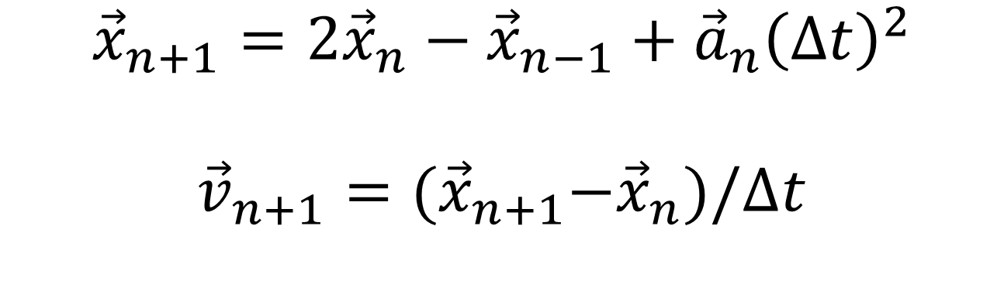
Störmer-Verlet integration algorithm
$${\vec{x}}_{n+1}={2\vec{x}}_{n}−{\vec{x}}_{n−1}+{\vec{a}}_{n}{\left(∆t\right)}^{2}$$
$${\vec{v}}_{n+1}={(\vec{x}}_{n+1}−{\vec{x}}_{n})/∆t$$
Another variant of Verlet algoritm
Use this for integrating dynamical system with a velocity-dependent acceleration, such as Lorentz force on a moving charge particle.
The cumulative error in the velocity is larger than that in velocity Verlet algorithm

Slide 44
Exercise: Charge moving in a magnetic field
A charge (mass m and charge q) moving with velocity v =(v_{x}, v_{y} , v_{z}) in a magnetic field B=(B_{x}, B_{y} , B_{z}) experiences a velocity-dependent Lorentz force F=(F_{x}, F_{y} , F_{z}) = q v × B. Develop a code based on the Störmer-Verlet integration algorithm to simulate the dynamical path of the charge particle moving through the magnetic field. Assume: q=+1 unit, mass m = 1 unit, initially located at (0,0,0), initial velocity (v_{0x},v_{0y}, v_{0z}), v_{0x}=v_{0y}=0.1 unit, v_{0z} =0.05 unit, B=(0, 0, B_{z}), B_{z} = 0.1 unit. You should see a helical trajectory circulating about the z-direction.
verlet_algorithm_3D_coulomb_helix.nb

