Slide 1
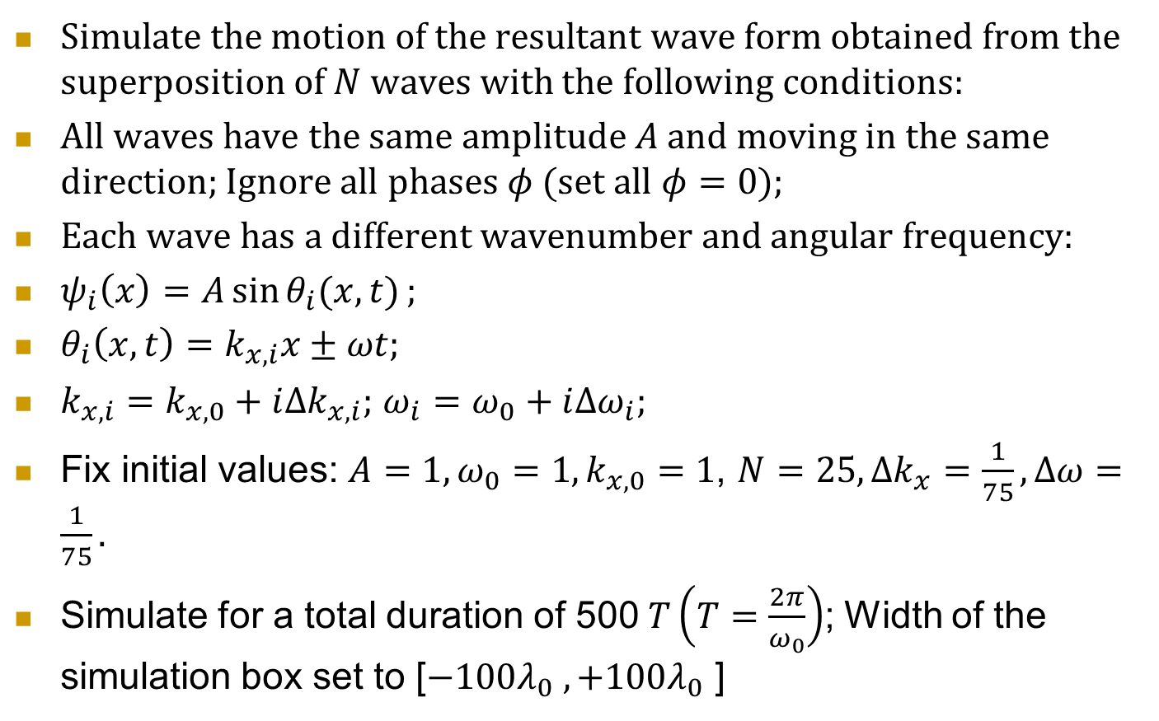
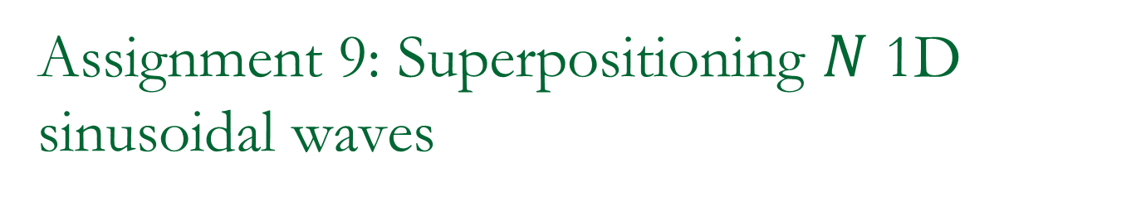
Assignment 9: Superpositioning $N$ 1D sinusoidal waves
Simulate the motion of the resultant wave form obtained from the superposition of $N$ waves with the following conditions:
All waves have the same amplitude $A$ and moving in the same direction; Ignore all phases $φ$ (set all $φ=0$);
Each wave has a different wavenumber and angular frequency:
$ψ_{i}\left(x\right)=A\sin{θ_{i}(x,t)};$
$θ_{i}\left(x,t\right)=k_{x,i}x±ωt;$
$k_{x,i}=k_{x,0}+i{Δk}_{x,i};$ $ω_{i}=ω_{0}+i{Δω}_{i};$
Fix initial values: $A=1, {ω_{0}=1, k}_{x,0}=1$, $N=25,{Δk}_{x}=\frac{1}{75}, Δω=\frac{1}{75}.$
Simulate for a total duration of 500$T\left(T=\frac{2π}{ω_{0}}\right)$; Width of the simulation box set to [$−100λ_{0} ,+100λ_{0}$ ]

Slide 2
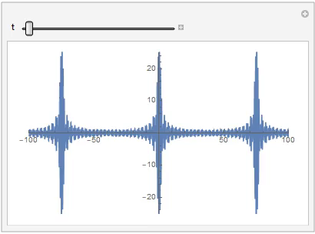
Your simulation should look like the following animation

