Slide 1
Assignment 11

Slide 2



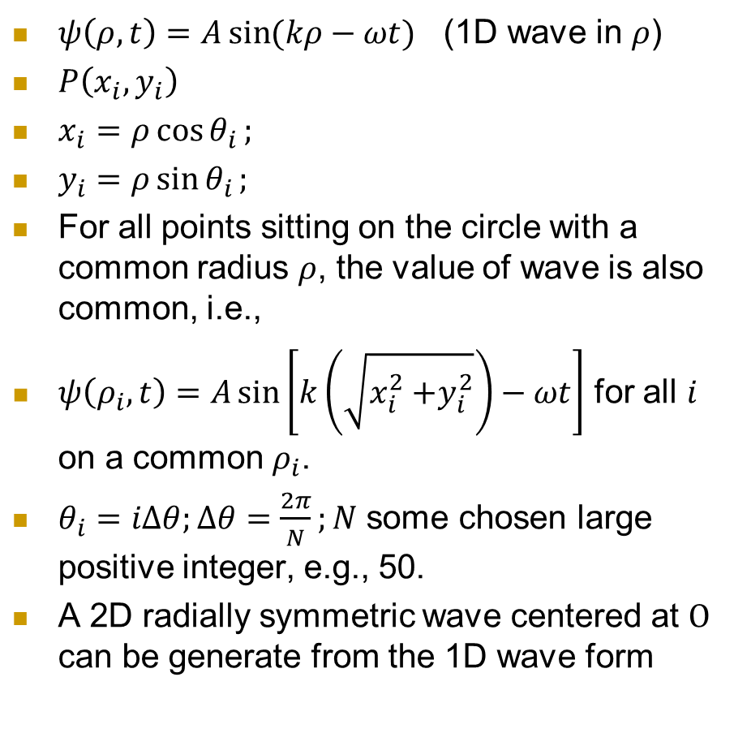





2D radially symmetric wave
$ψ\left(ρ,t\right)=A\sin{(kρ−ωt)}$ (1D wave in $ρ$)
$P\left(x_{i},y_{i}\right)$
$x_{i}=ρ\cos{θ_{i}};$
$y_{i}=ρ\sin{θ_{i}};$
For all points sitting on the circle with a common radius $ρ$, the value of wave is also common, i.e.,
$ψ\left(ρ_{i},t\right)=A\sin\left[k\left(\sqrt{x_{i}^{2}{+y}_{i}^{2}}\right)−ωt\right]$ for all $i$ on a common $ρ_{i}$.
$θ_{i}=iΔθ;Δθ=\frac{2π}{N};N$ some chosen large positive integer, e.g., 50.
A 2D radially symmetric wave centered at $O$ can be generate from the 1D wave form
$$y$$
$$P(x_{i},y_{i})$$
$$y_{i}$$
$$ρ_{i}$$
$$θ_{i}$$
$$x$$
$$O$$
$$x_{i}$$

Slide 3
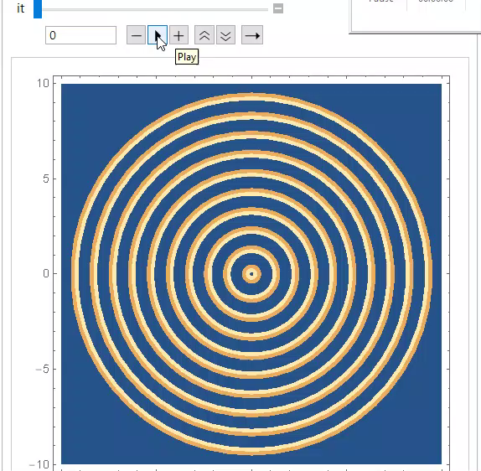
Visualise a 2D radial wave
To visualize it, use ListDensityPlot[ ]
You may need to impose the option InterpolationOrder -> 0 in ListDensityPlot[ ]

