Slide 1
Assignment 12

Slide 2
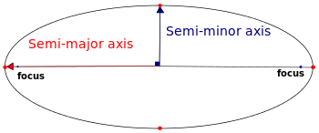
Q1. Simulate the simplified Sun-Earth-Moon three-body planetary motion
Assume constant angular velocities for both Earth and Moon
Elliptic orbits
$x−h=a\cos{ωt},$ $y−k=b\cos{ωt}$
Two set of parameters:
$a_{ES}$, $b_{ES}$, $ω_{ES}$, $h_{ES},k_{ES}$
$a_{ME}$, $b_{ME}$, $ω_{ME},h_{ME},k_{ME}$
Assume:
$b_{ME}=0.1b_{ES};a_{ME}=0.1a_{ES};$
${{\left(\frac{ω_{ES}}{ω_{ME}}\right)}^{2}\left(\frac{a_{ES}}{a_{ME}}\right)}^{3}=\frac{M_{S}}{M_{E}}=10;$
b
a
C(h,k)

Slide 3
You animation should look like the following:

Slide 4
Q2: Oscillating string
Animate the oscillating string as shown.

Slide 5
Q3
Animate a 2D spiral that oscillates radially in $xy$-plane. Your animation should show at least a few complete radial oscillations.

Slide 6
Q4 Lissajous pattern https://en.wikipedia.org/wiki/Lissajous_curve
$x=x_{A}\sin{{(ω}_{x}t});T_{x}=\frac{2π}{ω_{x}}$
$y=y_{A}\sin{{(ω}_{y}t+φ});T_{y}=\frac{2π}{ω_{y}}$
$φ=2π\left(ε+n\right);n=0,±1,±2,…;$
$0<ε<1.0$

Slide 7
Animate the Lissajous pattern for the following parameter
${ω_{x}=2ω}_{y};φ=0.15\left(2π\right);L=1;x_{A}=y_{A}=L$;

