Slide 1
Assignment 9

Slide 2
2D projectile motion
The trajectory of a 2D projectile with initial location ($x_{0}$, $y_{0}$), speed $v_{0}$ and launching angle $θ$ are given by the equations:
$$x\left(t\right)=x_{0}+v_{0}t\cos{θ;}$$
$$y\left(t\right)=y_{0}+v_{0}t\sin{θ+\frac{g}{2}t^{2}}$$
for t from 0 till T, defined as the time of flight,
T =-${2(y}_{0}+v_{0}\sin{θ)/g}$.
$g=−9.8$1;
Animate the 2D projectile. Your output should be similar to the video in the next slide.

Slide 3
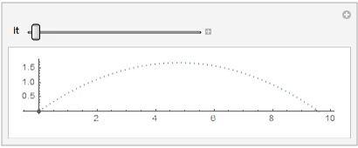

Slide 4
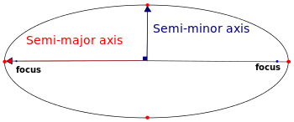
2-body Planetary motion
b
a
C(h,k)
Consider a planet orbiting the Sun which is located at one of the foci of the ellipse.
The coordinates of the planet at time t can be expressed in parametrised form:
$x(t)=h+acos(ω0t$), $y\left(t\right)=k+bsin\left(ω0t\right)$

Slide 5
2-body Planetary motion
b
a
C(h,k)
Given any arbitrary values of $h,k,a,b,ω_{0}$, simulate the motion of the planet for a full period (i.e., the planet should complete one round from the beginning till the end of the animation). Your output should be similar to the video in the next slide.

Slide 6
