Slide 1
Test 1
28 April 2017

Slide 2
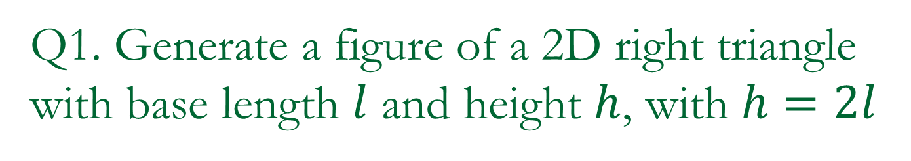
Q1. Generate a figure of a 2D right triangle with base length $l$ and height $h$, with $h=2l$

Slide 3
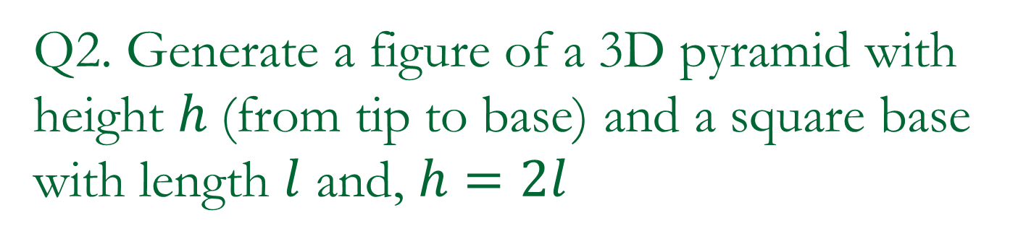
Q2. Generate a figure of a 3D pyramid with height $h$(from tip to base) and a square base with length $l$ and, $h=2l$

Slide 4
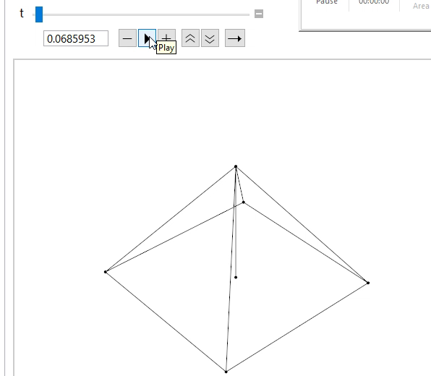
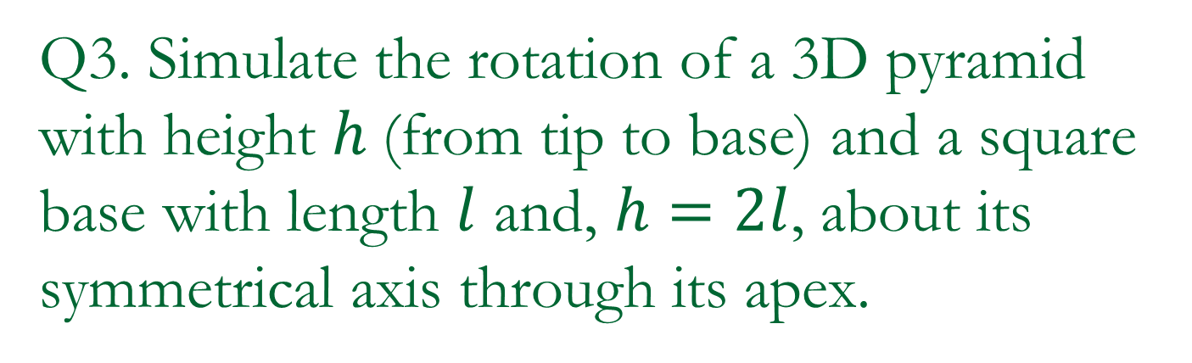
Q3. Simulate the rotation of a 3D pyramid with height $h$(from tip to base) and a square base with length $l$ and, $h=2l$, about its symmetrical axis through its apex.

Slide 5
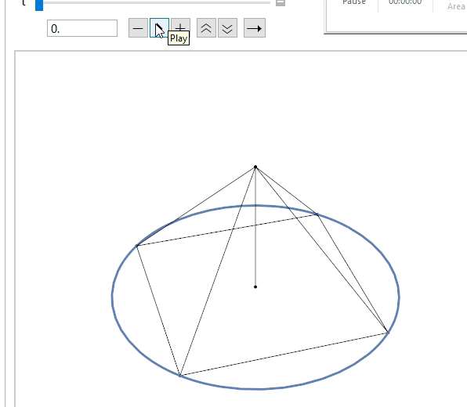
Q4. Modify your code in Q3 such that the corners of the base sit on a circular circumference.

Slide 6
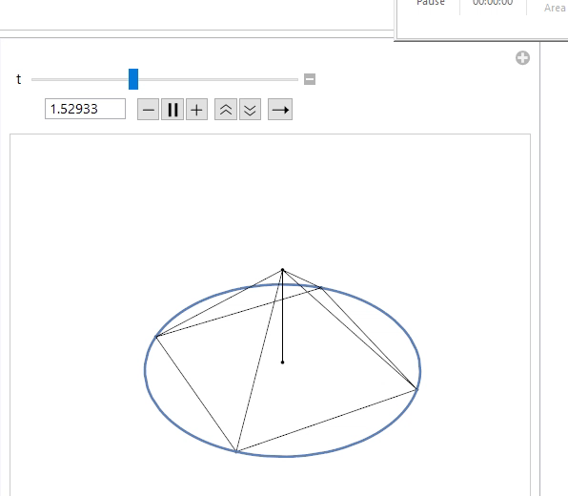
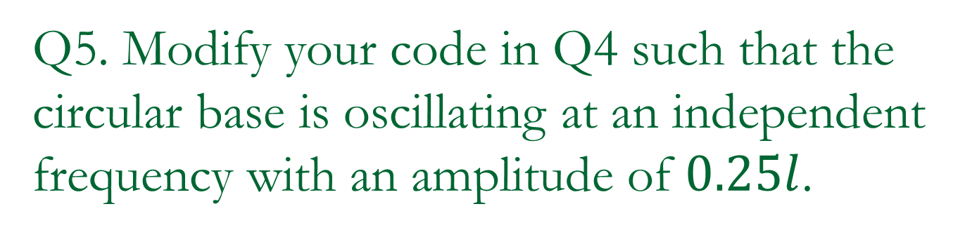
Q5. Modify your code in Q4 such that the circular base is oscillating at an independent frequency with an amplitude of $0.25l$.

