Slide 1
Test 2
Molecular dynamics simulation of hard spheres

Slide 2
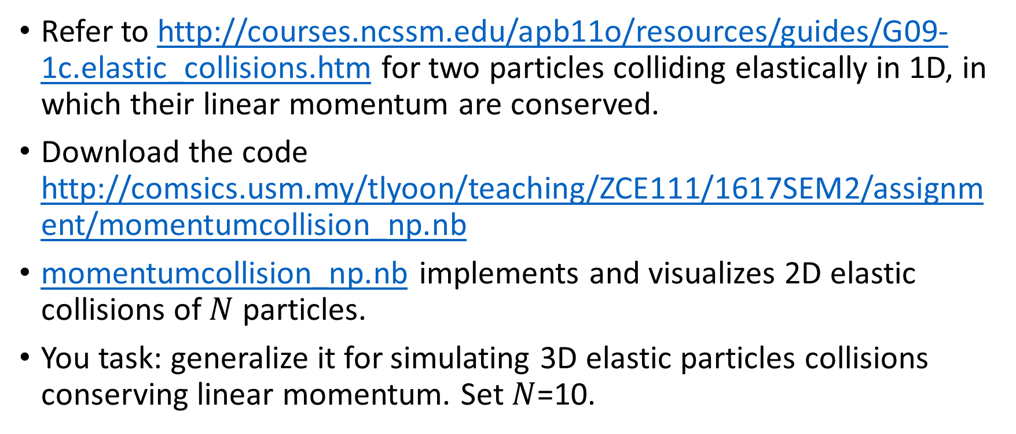
Refer to http://courses.ncssm.edu/apb11o/resources/guides/G09-1c.elastic_collisions.htm for two particles colliding elastically in 1D, in which their linear momentum are conserved.
Download the code http://comsics.usm.my/tlyoon/teaching/ZCE111/1617SEM2/assignment/momentumcollision_np.nb
momentumcollision_np.nb implements and visualizes 2D elastic collisions of $N$ particles.
You task: generalize it for simulating 3D elastic particles collisions conserving linear momentum. Set $N$=10.

Slide 3
