Slide 1
Lecture 2 Mathematica for Series

Slide 2
Use Mathematica to find the convergence of a series

Slide 3
1.
2.
3.
4.
5.
6.
7.

Slide 4
8.
9.
10.

Slide 5
Use Mathematica to generate a power series. Compare it to the function it converges to by plotting both on the same plot. Deduce the interval of convergence from the plot.

Slide 6
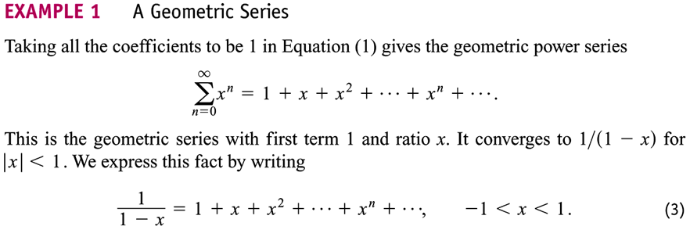

Slide 10
Use Mathematica to generate a Taylor series of a function $f(x)$ at a center $x=a$. Compare it to the generating function $f(x)$ by plotting both on the same plot. Deduce the interval of convergence from the plot.

Slide 11
Note: Maclaurin series is effectively a special case of Taylor series with a = 0.

Slide 12
Taylor series for f(x)=1/x expanded at the center $x=2$
f(x) = x⁻¹; f '(x) = -x⁻²; f ^{(n)}(x) = (-1)^{n} n! x^{-(n+1)}
The Taylor series is

Slide 13
Taylor series for e^{x} at x = 0

Slide 14
Taylor series for cos x at x = 0

Slide 15
Taylor series for ln x at x = 1
f(x)=ln x; f '(x) = x⁻¹;
f '' (x) = (-1) (1)x⁻²; f ''' (x) = (-1)² (2)(1) x⁻³ …
f ^{(n)}(x) = (-1) ^{n-1}(n-1)!x^{-n} ;

Slide 16
Binomial series

Slide 17
Consider the Taylor series generated by f(x) = (1+x)^{m}, where m is a constant:

Slide 18
The Taylor series of f(x) = (1+x)^{m}, is called the binomial series
This series is called the binomial series, converges absolutely for |x| < 1.

Slide 19
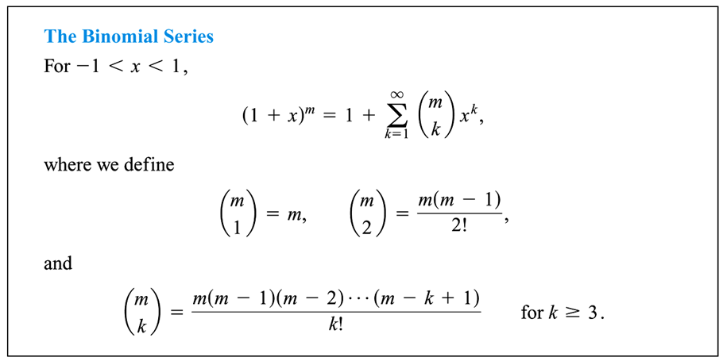
The Taylor series of f(x) = (1+x)^{m}, is called the binomial series

Slide 21
Generate the coefficients of the binomial series for (1+x)^{m} using Mathematica. Compare it to the generating function (1+x)^{m} by plotting both on the same plot. Deduce the interval of convergence from the plot.

Slide 22
Fourier series

Slide 23
A function f(x) defined on [0, 2π] can be represented by a Fourier series
y
Fourier series representation of f(x)
y = f(x)
x
0
2π

Slide 24
y
…
x
-2π
0
2π
4π
6π
8π

Slide 25
Fourier series representation of a function defined on the general interval [a,b]
For a function defined on the interval of [a,b] the Fourier series representation on [a,b] is actually
L=b - a

Slide 26
Example:
y
y=mL
x
-L
0
L
2L
a=0, b=L

Slide 28
Saw-tooth function
Consider the function $f\left(x\right)=mx$, where $m$ is the slope of the function, defined for $x∈\left\{0,L\right\}, L>0$. The Fourier coefficients are given by
$$a_{0}=\frac{mL}{2},a_{k}=0, b_{k}=−\frac{mL}{kπ}$$
Plot the Fourier series with $n=20$ terms for $x∈\left\{−2L,2L\right\}$, and overlap it with the function $f\left(x\right)$ on the same plot. Assume $L=m=1$.

Slide 29
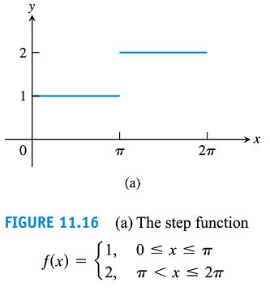
Fourier series of a step function

Slide 30
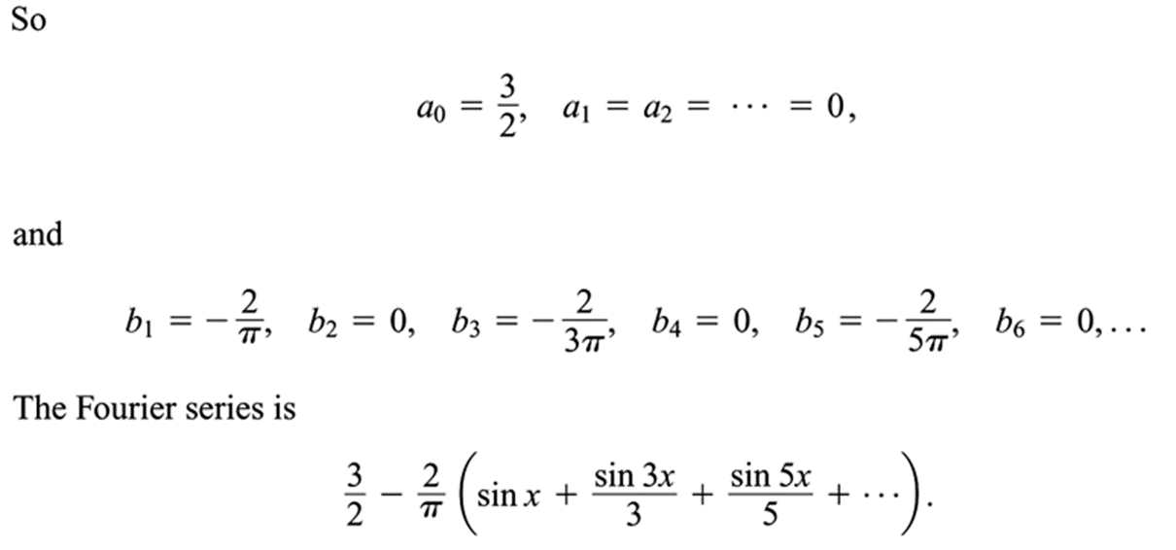
Plot the Fourier series of the step function using Mathematica

Slide 31
Plot the Fourier series of the step function using Mathematica

Slide 32
Taylor series revisited
Taylor series representation for an arbitrary function $f(x)$ at the center $x=a$ up to $n$-th order

Slide 33
Examples

Slide 34
A generic question to be solved
Given any arbitrary function $f(x)$, what is the analytical expression of the $i$-th coefficient in the Taylor series $P_{n}(x)$ for $f(x)$ at $x=a$?
Use Mathematica to for the explicit expression of $P_{n}(x)$ for $f(x)$ at $x=a$.
Plot $P_{n}(x)$ and $f(x)$ for a few selected values of $n$, covering a range of $x$ that includes $x=a$
Check the correctness of your answer using the command $Series[]$.

Slide 35
Try on these few functions
$f\left(x\right)=\tan^{−1}{x}$ at $x=1$.
$f\left(x\right)=\sinh^{−1}{x}$ at $x=0$
$f\left(x\right)=\frac{1}{\sqrt{{1−x}^{2}}}$ at $x=0$.

