Slide 1
Game of life

Slide 2
Introduction
A cellular automata
Developed by John Conway in 1970
Its evolution is determined by its initial state

Slide 3
Cellular automata
Perfect feedback machine
Each cell has its own state
A set of rules are defined
Rules are independent on the position of the group within the layer
Change state according to rules

Slide 4
Rules (1)

Slide 5
Rules (2)

Slide 6
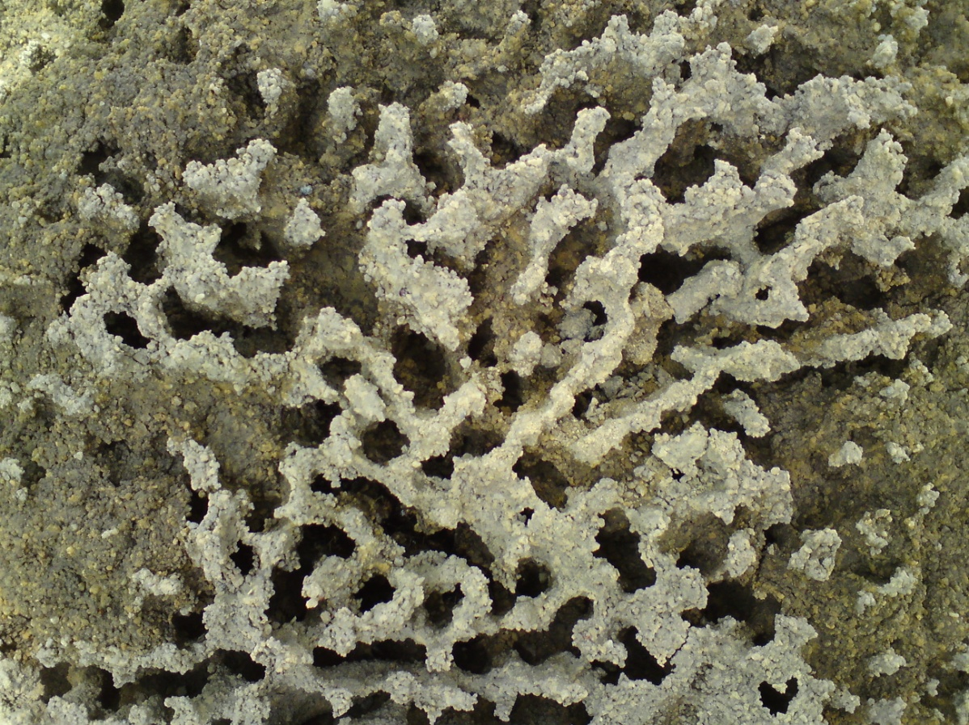
Majority rule

Slide 7
Micro-worlds
Coined at the MIT Media Lab Learning and Common Sense Group
A tiny world inside which a student can explore alternatives, test hypotheses, and discover facts that are true about that world
Differs from a simulation in that the student is encouraged to think about it as a "real" world, and not simply as a simulation of another world

Slide 8
Project 2
Rules:-
(1) The "Life" lives in harmony with nature. "Life", while obtaining resources from the mountain, forest or water sources, must not change the landscape of the Micro-world.
(2) In plain field, "Life" grows according to the "Game of Life".
(3) In plain field, "Life" gains resources (food, water) from mountain, forest, or water resources. Without resources, "Life" will die within one time step. With resources, "Life" may live as long as it is allowed by the "Game of Life" rule. A walk radius of 5 is given for the "Life" to gain resources from the surrounding.
(4) "Life" cannot live in water. If it falls into water, it will die at the next time step.
(5) Water is nourishing. If "Life" finds water within the walk radius, it will live and give birth to one of its random neighbours.
(6) Mountain can only support a minority group of "Life". This condition is set due to rule (1), as the number of "Life" increases in the mountain, certain destruction to the nature may occur.

Slide 9
Landscape generator
Use majority rule:-
If more than 5 cells alive, the evaluating cell will live (Mountain generator)
Sea surrounds the island

Slide 10
Population trend by the game of life

Slide 11
Population trend in the real world

Slide 12
Rules hadn’t considered
Civilization
War
Natural disasters
Weather pattern

Slide 13
Chaos Game and Genetics
In this project, chaos game is applied to
genetics so as to offer a visual
representation of the genetics code
rather than a series of confusing letters.

Slide 14
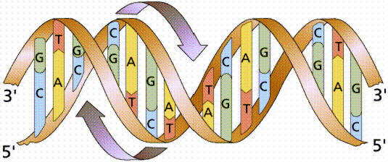
Chaos Game and Genetics

Slide 15
Chaos Game and Genetics
To put it simply, genetics when listed in the A, C, G, T codes looks like this:

Slide 16
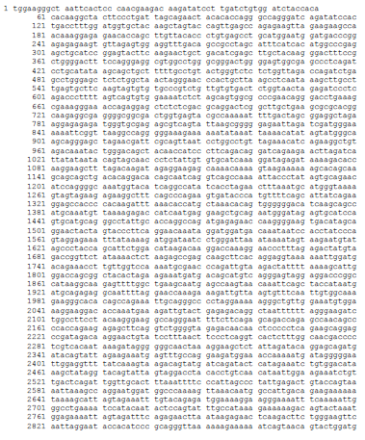

Slide 17
Chaos Game and Genetics
But that was just ONE-THIRD of it!
So, Chaos Game is an alternative representation of genetics.

Slide 18
Chaos Game and Genetics
Chaos Game Representation (CGR) is an
iterative mapping technique that processes
sequences of units, such as nucleotides in a
DNA sequence or amino acids in a protein,
in order to find the coordinates for their
position in a continuous space.

Slide 19
Chaos Game and Genetics
Genetics, which is made up of 4 acid amino strands named A, C, G and T.
In Chaos Game, it is visualised as a
4-sided square.

Slide 20
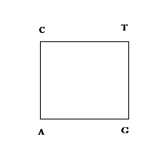
Chaos Game and Genetics

Slide 21
Chaos Game and Genetics
This is how the Chaos Game is applied:
DNA sequence is introduced.
Starting from the middle of the square, the next point is the midpoint of the previous point and the next point.

Slide 22
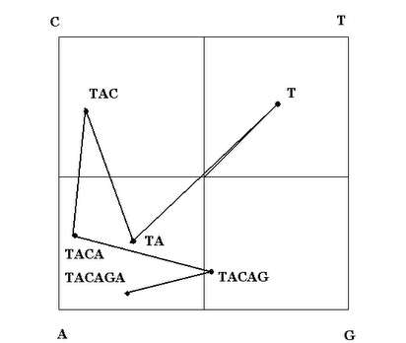
Chaos Game and Genetics

Slide 23
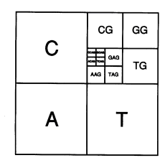
Chaos Game and Genetics
Upon close examination, it looks like this:

Slide 24
Chaos Game and Genetics
Hence it can be seen how each unique sequence will have a certain pattern, decided by the occupied and unoccupied space.

Slide 25
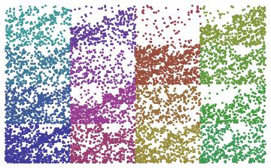
Chaos Game and Genetics
Human immunodeficiency virus (HIV)
Type 1 (HXB2) complete genome

